Slide 1
Privacy and Enterprise Risk Management
Association of Family Health Teams of Ontario
November 22, 2017
Karima Kanani & Kathryn Frelick

Slide 2
AGENDA
What is Enterprise Risk Management?
Risk Governance vs Management
Applying an Enterprise Risk Framework: Data Risk

Slide 3
What is Enterprise Risk Management?
Enterprise Risk Management (“ERM”) is defined as “a process that focuses an organization on the important risks to achievement of its overall objectives and then measures the degree to which the organization is successful in controlling these risks.”

Slide 4
What is Enterprise Risk Management?
Board and Corporate responsibility for risk
Focus is on achieving corporate objectives
Top-down awareness and bottom-up process
Risk identification and reporting
Risk management and tolerance
Creating an ERM culture

Slide 5
What is Enterprise Risk Management?
Addresses all types of risk across the organization
Intended to aggregate and evaluate risk information in combination with determining probability and impact on the organization's objectives as a whole
NOT the only risk assessment process, does not replace other risk management processes

Slide 6
What is Enterprise Risk Management?
ERM Framework:
Type of Risk (Reputational, Strategic, Operational, Legal)
Category of Risk (Quality of Care, Financial, Regulatory, Assets/Infrastructure, Business Continuity, Staff)
Impact
Likelihood
Mitigation Plan
Risk Tolerance

Slide 7
What is Enterprise Risk Management?
Industry challenges driving ERM:
A highly regulated and prescriptive environment
Significant dependency for funding
Product quality has direct consumer impact
An environment of absolute transparency

Slide 8
Duties and Responsibilities of Directors
Fiduciary – oversight/stewardship of operations and assets
Strategic – priorities and strategies re: resources, programs and services
Generative – underlying purpose and values; long term sustainability

Slide 9
Duties and Responsibilities of Directors
Generative
Framing questions; Shifting the cognitive paradigm
Fiduciary
Oversight and Policy
Strategic
Prospective and Reactive

Slide 10
Duties and Responsibilities of Directors
Act in best interest of the Corporation
Act with honesty and good faith
Confidentiality
Board solidarity (respect the decision of majority)
Avoidance of Conflict of Interest
Duty owed to the Corporation (not to any one group or interest)
All Directors owe same duty

Slide 11
Duties and Responsibilities of Directors
Standard of care and other responsibilities addressed in the Corporations Act and the Not-for-Profit Corporations Act
A Director must exercise the care, diligence and skill that a reasonably prudent person would exercise in comparable circumstances
Can’t delegate ultimate responsibility for risk

Slide 12
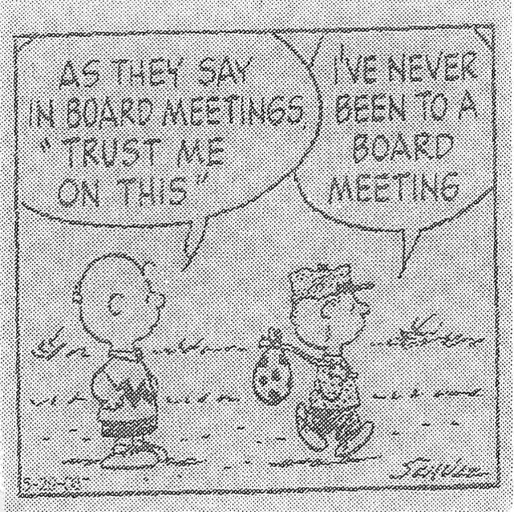
Duties and Responsibilities of Directors

Slide 13
Risk Governance vs Management
Alignment of:
→ Board responsibility for risk oversight
→ Management responsibility for risk management

Slide 14
Risk Governance vs Management
Board should:
Have understanding and oversight of key risk exposure and Management's intended response
Ensure appropriate programs and processes in place to protect against risk
Set organizational standard for risk appetite/tolerance
Engage an enterprise risk lens as part of Board decision-making

Slide 15
Risk Governance vs Management
Management should:
Identify, mitigate, manage and monitor risks to the organization on day-to-day and ad-hoc basis
Report to the Board material risks with mitigation and management strategies

Slide 16
Applying an Enterprise Risk Framework
Develop ERM reporting schedule and templates (risk register, dashboard, briefings)
ERM Board reporting does not need to be resource intensive, can streamline and create efficiency in Board engagement
Key is to adopt a consistent procedure to identifying and communicating risk

Slide 17
CASE STUDY: PRIVACY AND CYBER RISK

Slide 18
Board Responsibility for Privacy
Privacy protection of personal health information (PHI) → corporate obligation
Legislative compliance (PHIPA, PIPEDA)
“Person who operates” = corporation (HIC)
Obligation rests with the HIC – whether corporation or individual

Slide 19
HIC Obligations
Must comply with PHIPA
Must adopt information practices (policies and procedures) that address:
when, how and the purposes for which PHI is collected, used, disclosed, retained, destroyed
administrative, technical and physical safeguards
Reasonable steps to protect against theft, loss and unauthorized use or disclosure, unauthorized copying, modification or disposal

Slide 20
Understanding Privacy Risk
Component of business risk resulting from the collection, use, retention and disclosure of personal information
Privacy risks include privacy and data breaches, complaints, non-compliance or over-compliance, which could result in financial loss, operational disruption, stakeholder dissatisfaction, reputational loss

Slide 21
Examples of Privacy Breaches
Unauthorized collection of PHI
Video camera, camera phones, personal devices
Unauthorized disclosure of PHI
Lost or stolen laptop, computer equipment, storage devices
Inappropriate “recycling” or destruction of PHI
Intercepted video monitoring / wireless devices
Facebook / social media
Unauthorized use of PHI
Staff inappropriately accessing health record

Slide 22
What is Cyber Risk?
‘Cyber risk’ means any risk of financial loss, disruption or damage to the reputation of an organization from some sort of failure of its information technology systems or security
May result in theft, loss or unauthorized use or disclosure to PHI and trigger privacy obligations
Risk can be managed and reduced but not eliminated

Slide 23
Examples of Cyber Risks
Hacking - exploiting vulnerabilities in software and hardware
Exploiting security vulnerability – infected emails, malicious code, viruses
Malware, ransomware, phishing, infiltration
Theft, extortion, distortion or corruption of systems and data, identity theft
→ PHI is a valuable commodity

Slide 24
Privacy and Cyber Risk Management
Well suited to enterprise risk management framework
Align management's responsibility to manage operational risk and the Board’s responsibility to ensure risk oversight
Management of risk within organization’s risk tolerance

Slide 25
ERM Framework – Categories of Risk
Operational – conduct of core business
Financial/resources – funding, equipment
Strategic – reputational, business strategy
Compliance – legislation, regulations, rules and standards
Technological – information systems and devices

Slide 26
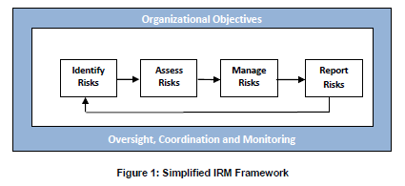
ERM Framework
Source: HIROC, Integrated Risk Management for Healthcare Organizations (2014)

Slide 27
1. Identify Risks
Events that may have a negative impact represent risks
Events that may have a positive impact represent opportunities (management can channel back as part of risk strategy)
Identify internal and external factors that could impact strategy and achievement of objectives

Slide 28
Internal/External Risks - Examples
Internal
Staff snooping
Multiple sites/locations
Lack of clarity re: roles and responsibilities under PHIPA
Use of laptops, external devices
Use of social media
Migration of EMR systems
New technologies/medical devices
Staff/physician movement/attrition
External
Hacking
Ransomware
Discontinuation of EMR systems
Funding constraints
Amendments to PHIPA (i.e. mandatory notification requirements, offences, fines)
LHIN/MOHLTC directives

Slide 29
2. Assess Risks
Understand the extent to which potential events might impact objectives
Assess risk from two perspectives:
Likelihood of risk (rare → almost certain)
Impact (insignificant → extreme)
Risk Matrix / Grading tool – rank risk, establish baseline and measure progress and trends over time

Slide 30
3. Manage Risks
Identify and evaluate possible responses
Evaluate in relation to risk appetite, cost / benefit analysis and degree to which a response will reduce impact or likelihood
Select and execute response based on evaluation

Slide 31
Managing Risks – ERM Strategies
Risk Management Strategy | Examples
Avoid | Do not start or terminate program or activity (i.e. technology or software that does not meet organizational privacy and security standards)
Remove | Discontinue obsolete or faulty software or system
Change Likelihood (prevent or reduce) | Enhanced training, policy development or system improvement, PIAs, TRAs
Change Consequences | Privacy breach protocol and security incident response
Risk sharing or risk transfer | Cyber Insurance Outsource or contract out
Retain Risk (informed decision) | Legacy systems and technologies

Slide 32
4. Report Risks
Regularly monitor and report on risks for senior leadership and Board
Analyze trends and progress towards performance goals over time

Slide 33
Best Practices for Reducing Liability
Information practices – policies, procedures and systems to address privacy and security
Information lifecycle – protect your informational assets from creation, storage, disposal, destruction
Contingency plans - Privacy breach protocol /security incident management, crisis and disaster management, data recovery
Tip: account for actions outside of workplace, for example, removal of data

Slide 34
Best Practices for Reducing Liability
Monitoring and auditing compliance coming under increasing focus – not enough to have privacy and security policies
Audit trails, regular and random privacy audits
Need to evaluate privacy and security standards as they evolve over time (i.e. use of fax, mail and courier, encryption, wireless systems)
Engage appropriate subject matter experts and ensure use of reputable vendors
Require vendors to demonstrate compliance

Slide 35
Best Practices for Reducing Liability
Training and education - privacy and cyber risks are as much about people as they are technology!
Service Provider Management
Risk assessment tools – including PIAs and TRAs
Internal reporting – systems for identifying and preventing breaches
Privacy notification and reporting

Slide 36
Best Practices for Reducing Liability
Responding to privacy or cyber breaches can be extremely costly and time consuming!
Early engagement of experienced legal counsel is critical (establish privilege for investigations)
Significant public relations and legal risk, therefore, when and how individuals are notified is very important → ensure strong communication strategy
Consider risk transfer and specialized insurance (i.e. D&O and cyber insurance)

Slide 37
Wrap Up
Directors have a duty to advance the best interests of the organization and this requires effective risk oversight
Risk analysis has evolved from reactive review/action to proactive management/mitigation
ERM involves risk analysis through an enterprise lens considering impact, likelihood, mitigation and tolerance
Implementation requires alignment of Board and Management roles and responsibilities
Consider ERM education and tools to enable effective implementation of ERM culture and process

Slide 38
Questions?
Karima Kanani
kkanani@millerthomson.com416.595.7908
Kathryn Frelick
kfrelick@millerthomson.com
416.595.2979

