Slide 1
WHMIS
Occupational Health & Safety

Slide 2

INTRODUCTION
Workplace
Hazardous
Materials
Information
System

Slide 3
Occupational Health & Safety
Administered by the Ministry of Labour,
WHMIS is a provincial law
under the
Occupational Health & Safety Act.

Slide 4
Why?
People who work in many environments
including healthcare or offices
can come into contact with chemicals.
Ex. paint, glue, cleaners, batteries, and other
products or equipment that contact chemicals.

Slide 5
Healthcare
As a healthcare worker, you may be exposed to potentially hazardous agents during:
Diagnostic tests
Maintenance activities
Housekeeping duties
Research activities
Therapeutic procedures

Slide 6
Right to Know
Employees have the right to know about products that could cause harm.
WHMIS regulates how hazardous materials
are used, handled and stored to
protect health, safety and the environment.

Slide 7
Background
In the early 80’s approximately 500,000 work related injuries were documentation each year.
Injuries and deaths were rising because of workplace hazardous materials.
As a result, in October 1988, WHMIS became
federal and provincial legislation.

Slide 8
WHMIS Works
Since the implementation of WHMIS,
there has been a steady statistical decline
in related workplace injuries and deaths.
WHMIS WORKS!

Slide 9
Safety
WHMIS is designed to ensure the safety of
employees and employers while in the workplace.
Information about the dangers and hazards
associated with chemicals at work is provided.
WHMIS is effective when all parties, including
suppliers, employers and employees
comply with the regulations while at work.

Slide 10
Compliance
WHMIS is the law.
Although every province has it’s own legislation, every workplace is required to comply.
Individuals or companies can be charged with an offense, and if convicted may be fined or jailed.

Slide 11
Education
Training Objectives:
Understand hazardous workplace materials.
Be able to identify controlled products.
Read product labels.
Locate MSDS (Material Safety Data Sheet).

Slide 12
GHS: Globally Harmonized System
In June 2011, international classification
and labeling rules were developed by the
Global Harmonized System (GHS)
in an effort to improve
hazardous communication standards.

Slide 13
Dangers
Without WHMIS
workplaces could be dangerous.
For example, exposure to some products may cause
health problems including nervous system, lung or
kidney damage, cancer, skin damage, etc.
Some products can cause explosions or fires.

Slide 14
3 Main Elements
LABELS To identify types of hazards and alert to dangers
as a precaution.
MSDS Provide detailed information on controlled
hazards, protection and emergency care.
3. EDUCATION Employers and employees require necessary
information about hazardous materials.

Slide 15
Responsibility
WHMIS is EVERYONE’S responsibility.
Supplier/Manufacturer
MSDS, Labels
Employer
Training, Safe Procedures
Employee
Informed, Proactive, Protected

Slide 16
Controlled Products
Controlled products are regulated by WHMIS in 6 classes.
CLASS A – COMPRESSED GAS
CLASS B – FLAMABLE AND COMBUSTIBLE MATERIAL
CLASS C – OXIDING MATERIAL
CLASS D – POISONOUS AND INFECTIOUS MATERIAL
Division 1 – Materials causing immediate and serious effects
Division 2 – Materials causing other toxic effects
Division 3 – Biohazardous Infectious Materials
CLASS E – CORROSIVE MATERIAL
CLASS F – DANGEROUSLY REACTIVE MATERIAL

Slide 17



 | CLASS A: COMPRESSED GAS This class includes compressed gases, dissolved gases, and gases liquefied by compression or refrigeration.
 | CLASS B: FLAMMABLE AND COMBUSTIBLE MATERIAL This class includes solids, liquids, and gases capable of catching fire in the presence of a spark or open flame under normal working conditions.
 | CLASS C: OXIDIZING MATERIAL These materials increase the risk of fire if they come in contact with flammable or combustible materials.

Slide 18



 | CLASS D: POISONOUS AND INFECTIOUS MATERIAL Division 1 - Materials Causing Immediate and Serious Toxic Effects These materials can cause death or immediate injury when a person is exposed to small amounts. Examples: sodium cyanide, hydrogen sulphide.
 | CLASS D: POISONOUS AND INFECTIOUS MATERIAL Division 2 - Materials Causing Other Toxic EFFECTS These materials can cause life-threatening and serious long-term health problems as well as less severe but immediate reactions in a person who is repeatedly exposed to small amounts.
 | CLASS D: POISONOUS AND INFECTIOUS MATERIAL Division 3 - Biohazardous Infectious MATERIAL These materials contain harmful micro-organisms that have been classified into Risk Groups 2, 3, and 4 as determined by the World Health Organization (WHO) or the Medical Research Council of Canada.

Slide 19


 | CLASS E: CORROSIVE MATERIAL This class includes caustic and acid materials that can destroy the skin or eat through metals. Examples: sodium hydroxide, hydrochloric acid, nitric acid
 | CLASS F: DANGEROUSLY REACTIVE MATERIAL These products may self-react dangerously (for example, they may explode) upon standing or when exposed to physical shock or to increased pressure or temperature, or they emit toxic gases when exposed to water.

Slide 20
Healthcare Controlled Products
Common in healthcare:
Formaldehyde (sample tubes)
Oxygen Cylinders
Metricide (disinfectant)
Chlorhexidine (wipes)
N20 Anaesthic Gas
Sodium Hypochorite (bleach)
Liquid Nitrogen
Aerosols
Acetone
Others

Slide 21
Labels
WHMIS enforces informative container labels.
The purpose of a label is to identify
if it is a controlled product, nature of risk
(ie. flammable), and safe handling information.

Slide 22
Supplier Labels
SUPPLIER LABELS
Product Identifier (material by chemical, brand or trade name)
Hazard Symbols (represents classes and divisions under WHMIS)
Risk Phrases (explained risks eg. harmful vapour)
Precautionary Measures (storing eg. keep away from heat)
First-Aid Measures (immediate action eg. do not induce vomiting)
Supplier Info (contact address, emergency phone #)
Reference to MSDS (availability of the Material Data Sheet)
*Supplier labels have a distinctive hatched border.
*If the label is missing, contact your manager or supervisor immediately.

Slide 23
Workplace & Laboratory Labels
WORKPLACE LABELS
Product Identifier (material by chemical, brand or trade name)
Precautionary Measures (essential handling or use precautions)
Reference to MSDS (availability of the Material Data Sheet)
* Workplace labels do not require a hatched border or other symbols.
LABORATORY LABELS
For lab workplaces, job specific applications of WHMIS guidelines are available.
* A controlled product intended for Lab use only, does not need a supplier label if it
comes from a lab supply house or weighs less than 10 kilograms.

Slide 24
Healthcare Occupations
How does WHMIS affect healthcare occupations?
Clinical Staff
(including all IHPs and Support Staff)
Doctors
Laboratory
Janitorial
Maintenance
Administration
IHP: Interdisciplinary Health Professional

Slide 25
Protection
Personal protective equipment
are not just suggestions.
Wear it! Use it!

Slide 26










 | Dust mask required A NIOSH approved N95 dust mask must be used.
Air Purifying Respirator A NIOSH approved chemical cartridge respirator must be used. Use requires special training.
 | Supplied Air Respirator A NIOSH approved SCBA or Supplied Air system must be used. Use requires special training.
 | Apron An apron made of material resistant to the hazardous material must be worn..
 | Chemical Protective Clothing Either a hooded or fully-encapsulating suit of appropriate material must be worn.
 | Goggles C.S.A. approved chemical-resistant, splash-proof goggles must be worn.
 | Face Shield C.S.A. approved face shield must be worn. Note: C.S.A. approved safety glasses or goggles must also be worn with this device.
 | Foot Protection C.S.A. approved protective footwear appropriate to the hazard must be worn.
 | Hand Protection Gloves offering appropriate protection to the hazard must be worn.

Slide 27
MSDS: Material Safety Data Sheets
MSDS is a document that contains detailed information
on safe handling for a controlled hazardous product.
For controlled products used in your workplace, MSDS are filed and/or available online by searching “MSDS Quick Search”.
Read and understand MSDS information
before handing a controlled product.

Slide 28
MSDS Categories
Hazardous Ingredients (lists by hazard classes)
Preparation Information (contact of who prepared the MSDS + date prepared)
Product Information (trade name, chemical family, supplier, mfg, emergency #)
Physical Data (how product behaves when used)
Fire and Explosion Data (likelihood under circumstances)
Reactivity Data (stability of material under varied exposures)
Toxicological Properties (explains health effects; exposure; entry)
Preventative Measures (safe handling, storage, protective controls)
First Aid Measures (immediate treatment for exposure)

Slide 29
Hazardous Materials
Hazardous materials in the workplace are classified into
3 categories:
BIOLOGICAL These are living organisms or properties. Ex. Needle-stick injury
could be an accidental exposure to possible blood borne pathogens.
CHEMICAL These include inhaled fumes or powders and skin contact from
splashes, spills or touch.
PHYSICAL These are environmental, such as temperature, noise, vibration and
radiation.

Slide 30
SUMMARY
Responsibilities:
SUPPLIER/MANUFACTURER
Provide information, labels and MSDS.
Classify hazardous and WHMIS controlled products
EMPLOYER
Implement WHMIS program.
Educate employees.
Prepare and maintain an inventory of hazardous materials in the workplace.
EMPLOYEE
Participate in WHMIS training and apply this knowledge on the job.
Review labels and MSDS before use.
Report damaged, illegible or missing labels or MSDS to your supervisor or manager.
Sources:
Health Canada - www.hc-sc.gc.ca/ewh-semt/occup-travail/whmis-simdut/index-eng/php
Occupational Safety - www.ccohs.ca

Slide 31
WHMIS SUCCESS
The goal of WHMIS is to create
a safe and healthy workplace.
WHMIS is successful when we work safely.

Slide 32
YOUR JOB
Now that you’ve completed a review of what
WHMIS is and why awareness is necessary…
Please take time now to consider how
WHMIS affects YOU in YOUR job.
Make a list. Take appropriate action.

Slide 33

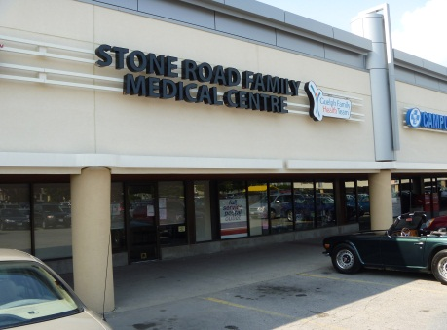
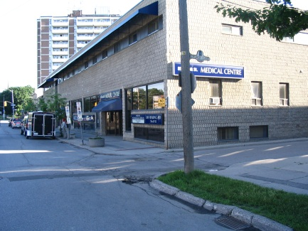


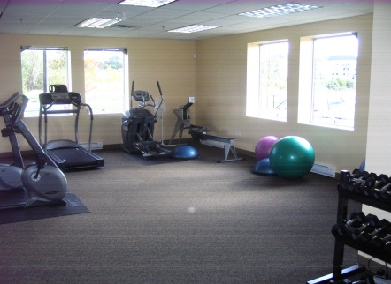
Thank you!

