Slide 1
Customer Service
Accessibility Standard
AODA: Access for Ontarians with Disabilities Act

Slide 2
AODA Overview
Compliance with ‘Accessibility Standards for Customer Service’ is required by January 1, 2012.
This is a regulation of the Accessibility for Ontarians with Disabilities Act (AODA).
The Ontario government is putting standards in place for:
Customer Service
Employment
Information and Communication
Transportation
Built Environment

Slide 3
The Accessibility Standard for Customer Service
applies to all people or organizations in Ontario that:
• Provide goods or services
• Have one or more employees
This applies to private, non-profit and public sectors.

Slide 4
What is ‘accessible customer service’?
Accessible customer service is
not about ramps or automatic door openers.
It’s about understanding that people with disabilities may have different needs.

Slide 5
Commitment to Accessibility
Guelph Family Health Team is committed
to providing a welcoming and accommodating
environment for all persons,
including those with disabilities.

Slide 6
Compliance Requirements
Step 1: Create and implement an accessibility plan
Step 2: Provide training
Step 3: Communication
Step 4: Reporting

Slide 7
Customer Service Plan
Step 1: Create Accessibility Plan
Consider a person’s disability when communicating with them.
Allow assistive devices in the workplace such as wheelchairs, walkers, oxygen tanks, etc.
Allow service animals.
Welcome support persons.
Let customers know when accessible services aren’t available.
Invite customers to provide feedback.

Slide 8
Training
Step 2: Provide Training
Train all employees about accessible customer service.

Slide 9
Communication & Reporting
Step 3: Share the Plan
Let customers know (post it in the facility, website).
Offer the plan in accessible formats such as large print
if requested.
Step 4: Report Progress
Report progress online to the Ontario government.

Slide 10
Considerations
Be customer service considerate using the principles of independence, dignity, integration and equality.
Tips:
Consider what you do every day to provide customer service.
Identify potential barriers for people with disabilities.
Use this information to refresh existing or to create new ways of doing things to improve accessibility to customer service.

Slide 11
Accessibility Considerations
Examples:
A clothing store might reconsider a no-refund return policy because the fitting rooms are not wheelchair accessible.
A grocery store may decide to place rolls of plastic bags for produce on lower shelves to ensure that people who use mobility devices can access the bags.
What would be some accessibility
considerations at GFHT?

Slide 12
Communication
Consider disabilities when communicating.
Accessible customer service is about finding ways around barriers to deliver accessible customer service.
Tips:
Consider how people with various disabilities communicate.
Ask your customers how you can best communicate with them.
What can you do to make communication accessible?
Every situation is different and depends on the individual’s needs

Slide 13
Accessible Communication
Examples:
A class schedule in paper format is available at the front desk. When a customer with vision impairment asks for the schedule in Braille, an employee explains it is in an accessible format on the website and asks if this would be suitable. The customer agrees because a screen reader at home reads what is displayed on websites.
Another customer who has a learning disability is having difficulty understanding a particular part of the schedule and simply asks the employee to read that part aloud.
What are some accessibility considerations
for communication at GFHT?

Slide 14
Assistive Devices
Allow assistive devices.
An assistive device is any piece of equipment a person with a disability uses to help them with daily living. These may be a wheelchair, screen reader, listening device, etc.
Tips:
Consider potential customer’s assistive devices.
How will you offer helpful measures, such as automatic doors?
Are there any restrictions or dangers on your premises?

Slide 15
Assistive Devices Accommodation
Example:
Janet can walk short distances and uses a scooter. It is often difficult to find space to park her scooter. She finds it helpful when staff suggest parking options and make space.
What are some accommodations we could
make for assistive devices at GFHT?

Slide 16
Service Animals
Allow service animals.
Guide dogs are not the only type of service animal. Other kinds of animals can be trained to help people with disabilities too.
Welcome service animals into your workplace or business. If a service animal is excluded by law, provide another ways to access your goods and services.
Tips:
Identify the areas of your premises open to service animals.
Do you need to do anything differently to serve people with service animals?

Slide 17
Service Animal Considerations
Example:
A restaurant allows service animals into the dining room but since other legislation prevents animals from entering the kitchen, staff meet with a food product sales rep who requires a guide dog in the office area.
What considerations for service animals
are applicable at GFHT?

Slide 18
Support Persons
Welcome support persons.
A support person may be a paid support worker, family member or friend.
Support persons help those with a disability to perform daily tasks. Often people who have a support person are not able to do some things independently, such use the washroom.
Without support, that person may be unable to access your organization or services.
Tips:
Think about how your services are used by people with a support person.
Decide how you will deal with special situations or services.
Consider what parts of your premises are open to the public.

Slide 19
Support Persons Provisions
Example:
A theatre posts a notice on its website and at a ticket window that support persons will be charged partial admission fee when accompanying a person with a disability.
What are some provisions offered or could be
offered to support persons at GFHT?

Slide 20
Available Services
Let customers know when accessible services aren’t available.
Sometimes accessibility features or services require repair or are temporarily out of service, such as an elevator or accessible washroom. Post a notice when this happens.
Tips:
Make a list of the facilities and services people with disabilities rely on.
Prepare a notice, including the reason for the disruption, how long the service will be unavailable and identify alternative facilities or services, if available.
Post the notice in a place or places where people are most likely to find it (eg. the entrance door to your business, on your website, another high-traffic area).

Slide 21
Available Service Notification
Example:
A dry cleaning business must remove the ramp in front of their store for a few weeks during repair. They post a sign outside and leave a message on their phone explaining the situation. Both the sign and the message explain the repair, the date when the ramp will be available again, and offer to meet customers outside if they call ahead in order to pick up or drop off garments.
What are some service notifications
that may be required by GFHT?

Slide 22
Customer Feedback
Invite customers to provide feedback.
A good way to learn about barriers that exist in your workplace is to collect comments from your customers with disabilities.
Invite customers to give feedback on how you provide accessible customer service.
Tips:
Determine how to receive feedback (eg. in person, by telephone, in writing or by email).
How will you respond to feedback, including complaints? How will you let customers know about the process?

Slide 23
Customer Feedback Methods
Example:
A hotel posts a notice in the lobby and on the guest receipt that visitor feedback is appreciated and can be submitted at the front desk, by phone or through the hotel’s website.
What are best methods to collect
customer feedback at GFHT?

Slide 24
Summary
Remember to be accommodating.
Our client service standard is…
“How can I help you?”

Slide 25

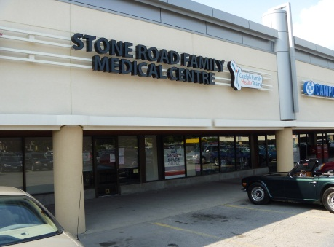
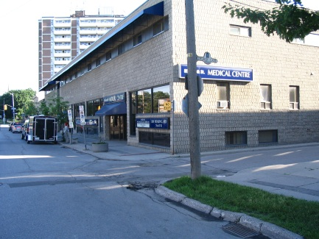
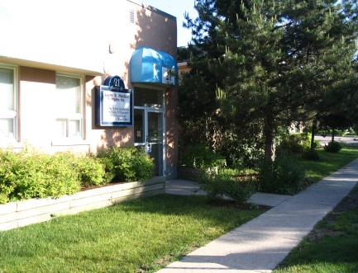
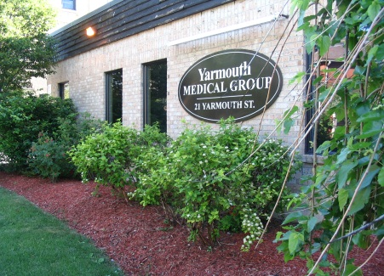
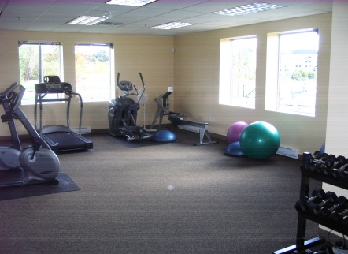
Thank you!

