Slide 1

Privacy Training for FHT Boards
Association of Family Health Teams of Ontario
Kate Dewhirst
February 3, 2016

Slide 2
Question 1
In a FHT/FHO* relationship, who is the “Health Information Custodian”?

Slide 3
PHIPA Applies to:
“Health information custodians” (HICs) that collect, use, and disclose personal health information (PHI) [The FHT or FHO* - see new AFHTO tool]
“Agents” of HICs (incl. employees, physicians, allied health professionals, vendors, students and volunteers acting on behalf of a HIC)

Slide 4
Who are Health Information Custodians?
Health care practitioners*(including group practices likes FHTs and FHO*s)
Public hospitals
Private hospitals
Psychiatric facilities
Independent health facilities
CCACs
Community health or mental health centres, programs or services (primary purpose is provision of health care)
Long-term care homes
Placement coordinators
Retirement homes
Pharmacies
Laboratories
Specimen collection centre
Ambulance services
Operators of care homes (residential tenancies)
Homes for special care
Community support services provider (under Home Care and Community Services Act, 1994)
Minister of Health and Long-Term Care
HCCA evaluators or SDA assessor
Medical Officer of Health
Or as prescribed

Slide 5
HICs
A health care practitioner or a person who operates a group practice of health care practitioners
Who is the HIC?
Usually is the FHO* (or individual physicians)
The HIC has all the responsibilities under PHIPA (some duties can be delegated)

Slide 6
Question 2
What do HICs have to do?

Slide 7
AFHTO Statutory Compliance
Duty: As a health information custodian (or agent), every FHT has a duty to protect personal health information
Questions the Board should ask:
Are we a HIC? Or are we an agent of a HIC (being the FHO* or our affiliated physicians)?
Does the FHT have a Privacy Officer?
What steps has the FHT taken to ensure that it is PHIPA compliant?

Slide 8
AFHTO Statutory Compliance
How does the FHT ensure and monitor third party access to personal health information?
When was the last review/audit of the FHT’s privacy policy and/or procedures?
When did the FHT last train the staff on privacy issues?
Has the FHT had any privacy breaches? If so, what steps have been taken to prevent recurrence?

Slide 9
Privacy Compliance Elements
Appoint a privacy officer
Post information management practices (staff/patients/public)
Have clear rules about privacy (usually in policy)
Ensure agents are informed about their duties under PHIPA (training)
Respond to public inquiries
Respond to requests for access/correction to a record of PHI
Perform Privacy Impact Assessments for new technology
Audit for compliance
Receive and respond to complaints
Take reasonable steps to ensure accuracy of PHI
Ensure protection of PHI against loss, theft, unauthorized access, use or disclosure, copying, modification, disposal (and notify affected individuals if there has been a privacy breach)
Ensure that records of PHI are retained, transferred and disposed of in a secure manner

Slide 10
Privacy Compliance Status
Requirement | Status | Notes
Privacy Contact Person
Statement of information management practices
Privacy policies
Training for agents
Process for responding to requests for access/correction
Process for responding to privacy complaints/breaches

Slide 11
Privacy Compliance Status
Requirement | Status | Notes
Privacy impact assessments for new technology
Audit for compliance
Contracts with vendors supplying IT services, confidential shredding and off-site storage reviewed
Information security strategy
Fees
Confidentiality pledges
eMR privacy flags + privacy reminders

Slide 12
Question 3
What privacy laws, rules and resources do FHTs/FHO*s need to know about and review?

Slide 13
Privacy Rules for FHTs
PHIPA
Information & Privacy Commissioner of Ontario Orders – now there are 22
College guidelines
Organizational Policies – such as:
Privacy Policy; (2) Public Privacy Statement; (3) Safeguards; (4) Lockbox; (5) Privacy Breach Protocol; (6) ROI – Access and Correction; (7) Privacy Impact Assessment

Slide 14
Question 4
Why should the Board care about the privacy legislation? What impact could it have on the FHT? What are the penalties?

Slide 15
Consequences for Breach of Privacy
Personal cost to patients and therapeutic relationship
Individuals may complain to FHT and then to Privacy Commissioner (IPC)
IPC has power to initiate investigations and has broad order-making powers
Damages for breach of privacy in court (class actions)
Offences with fines of $50K/$250K (Bill 119 – at second reading - would double these fines and require reports to IPC/O & Colleges)
Prosecutions by Attorney General
Regulatory Colleges have power to take disciplinary action
Employer can take disciplinary action including termination of employment or contract

Slide 16
Question 5
What privacy rights do patients have?

Slide 17
Individual Rights under PHIPA
Subject to some exceptions, an individual has a:
Right to consent (or withhold or withdraw consent) to the collection, use or disclose of PHI
Right to have access to PHI (regardless of where it is kept)
Right to ask for a correction to a record of PHI
Right to “lock” PHI from health care providers for health care purposes (“lockbox”)
AND OTHER RIGHTS

Slide 18
Question 6
What happens if PHI is lost, stolen, accessed by someone inappropriately?

Slide 19
Lost, Stolen or Unauthorized Uses and Disclosures
A HIC is required to notify the person if his or her information is lost, stolen or used by or disclosed to an unauthorized person
FHT/FHO* staff must notify the Privacy Officer if this happens
After Bill 119 – likely will also need to report to IPC

Slide 20
Security is a HUGE issue
Fax with test results is misdirected
An unencrypted laptop with health information saved on the hard drive is stolen
An unencrypted USB key is lost
A patient reads another patient’s health record on a computer while waiting in a clinic room
Health records are recycled and not shredded
Out of curiosity, a staff member reviews an ex-boyfriend’s chart
Staff send an email with patient data to a “help desk” – but send to the help desk at a bank
Student looks through eMR for self-initiated educational purposes and not as directed by the instructor or preceptor

Slide 21
A staff member makes a copy of an ex-spouse’s health record
Staff discuss patients in hallways and lunchrooms and other patients overhear (even colleagues overhear)
Staff release information to another health care provider when a patient has said she doesn’t want that provider to know
Staff release information to a spouse when the patient doesn’t want that spouse to know
Staff release information to a child’s parent when the child is capable of making his own decisions and said don’t tell my parents

Slide 22
Question 7
Are there privacy practice standards that FHTs/FHO*s should know about?

Slide 23
IPC Orders and Decisions
2005-2011
11 orders
2014-2016
11 orders/ decisions

Slide 24
IPC Orders Themes
Vendors
Orders 1, 6, 11
Snooping
Orders 2, 10, 13, 16
Mobile Devices and New Technology
Orders 4, 5, 7, 8,
Access and Correction
Orders 9, 12, 14, 15, 17, 18
Closing a Practice
Order 3
Disclosing Records of Deceased
Orders 19-22

Slide 25
Dealing with Vendors

Slide 26
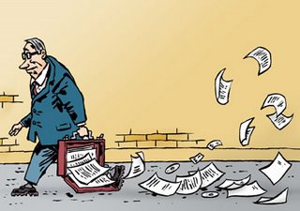
Real Life Privacy Breaches
Order #1 – PHI on streets as part of film shoot
Order #6 –PHI scattered on the street outside medical centre with medical lab
Order #11 – CCO couriered Screening Reports but they never arrived

Slide 27
Real Life Privacy Breaches
Review physical storage policies and procedures
Have written contracts with third parties that transport, retain, destroy PHI
Confetti shredders
Reminder: Look at contracts with vendors for shredding
Do PIAs – for all new initiatives and technology

Slide 28
Closing a Practice

Slide 29
Real Life Privacy Breaches
Order #3 – Medical clinic abandons records when it closes
Duty to address records when closing a practice or retiring or moving
CPSO has guidelines
Be careful when renovating offices

Slide 30
Snooping

Slide 31
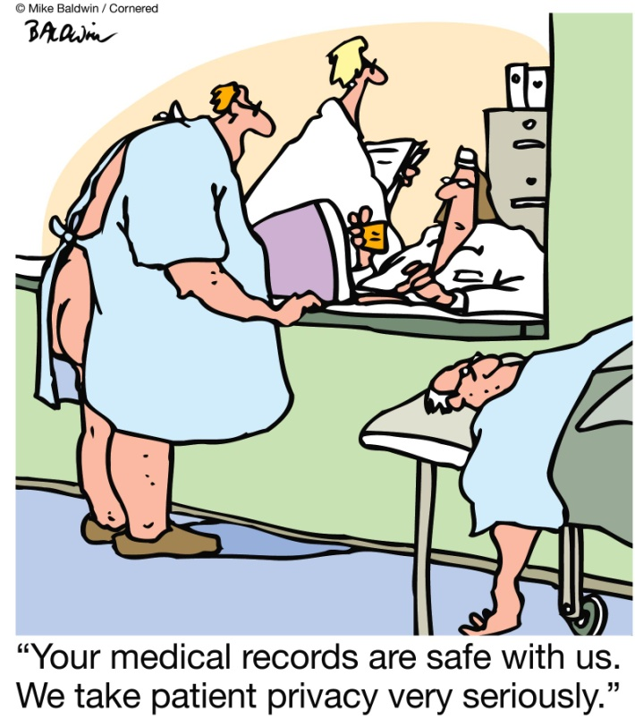
Real Life Privacy Breaches
Orders #2 & 10 (same hospital) - Inappropriate access by employee to PHI of boyfriend’s “ex” (#2) and former husband’s wife (#10)
Instill a “culture of privacy”
Implement safeguards (lockbox) when patient presents concerns
Prompt investigations and remedial action
Role-based access

Slide 32
Real Life Privacy Breaches
Order #13
Selling of information about new mothers and new babies to RESP providers
Securities Commission fine: $36K + $9K to victims’ fund
Also linked to Securities Commission prosecution + class action ($400 million possibly 14,000 patients affected)
Reminders:
Training
Audits (even when outside your control)
Policies
Confidentiality pledges

Slide 33
Recent Recommendations from IPC/O
Annual confidentiality pledges
Monthly random audits of electronic medical records to monitor for privacy breaches and inappropriate access to patient records
Flag (to the extent that it is possible) likely targets of inappropriate access by staff (such as family members of FHT staff and high-profile individuals in the community)
Privacy warning to the electronic medical record to pop up automatically upon log-in
Privacy training should be repeated on a yearly basis to include IPC/O videos, in-house privacy training and different speakers

Slide 34
Real Life Privacy Breaches
Jones v. Tsige, 2012
Bank employees
Tsige has common law relationship with Jones’ ex
Tsige looked at Jones’ financial information 174 times in 4 years
$10,000 damages (but the Court said, up to $20,000 for new tort of intrusion upon seclusion)

Slide 35
Jones, cont’d
An unauthorized intrusion;
The intrusion was highly offensive to a reasonable person;
The matter intruded upon was private; and
The intrusion caused anguish and suffering (although the Court suggests this last one will be assumed when the first three are satisfied)

Slide 36
Hopkins v. Kay 2015
The respondent, Erkenraadje Wensvoort, was one of 280 patients who had their health information improperly accessed and who were notified of the breach, as is required by PHIPA.
The respondent had previously sought medical care for injuries inflicted by her ex-husband, whom she had subsequently left and hidden from. She feared that the breach was actually an attempt by him to locate her.
Hospital admitted privacy breach and said it was intentional
Individuals have a right to sue outside the scheme set out in PHIPA
PHIPA says plaintiffs can sue after the IPC/O issues an order and then only for “actual harm”
Court recognized Jones v. Tsige (not required to prove actual harm and quantum of damages is higher than allowed under PHIPA)
HICs now potentially exposed to greater damage awards (+280 plaintiffs!)
No good faith immunity
Decision upheld by Court of Appeal in 2015 and SCC has refused to hear an appeal so the decision stands
Class action free to proceed

Slide 37
Real Life Privacy Breaches
Decision #16
IPC refused a doctor’s request to defer the IPC’s review until the CPSO investigation has concluded
Former patient of a medical clinic alleges that her ex-spouse obtained her medical records from the clinic and from the hospital without her consent (he was not her health care provider)
She alleges he gained access to the records through deception and then shared the records in a court proceeding
IPC concluded that because:
The CPSO investigation may not resolve quickly
There was no evidence of prejudice to the respondent physician (other than inconvenience in responding to two proceedings)
Orders and recommendations are different b/c IPC and CPSO
The CPSO outcome would not narrow the issue at hand for the IPC

Slide 38
Snooping Prosecutions
North Bay nurse looked at 5804 patient records – case dropped by Attorney General because of delay of process (16 months)
3 hospital staff members are being prosecuted for privacy breaches involving a high profile patient
Charges have been laid involving a student looking at records at a medical clinic

Slide 39
Arbitration case
Ontario arbitration North Bay Regional Health Centre 2012
Nurse looked at 5804 patient records – case dropped by Attorney General because of delay of process (16 months)
Daily review of health records out of personal interest and “learning”
Her termination of employment was upheld by arbitrator

Slide 40
Snooping Video
45 minute video: https://www.youtube.com/watch?v=2DddxHvJPcY

Slide 41
Portable Devices and Technology

Slide 42
Real Life Privacy Breaches
Order #4 - Theft of laptop computer containing PHI of 2900 patients
Develop “a comprehensive corporate policy that, to the extent possible and without hindering the provision of health care, prohibits the removal of identifiable PHI in any form from the hospital premises. To the extent that PHI in identifiable form must be removed in electronic form, it must be encrypted.”
TAHSN Guidelines

Slide 43
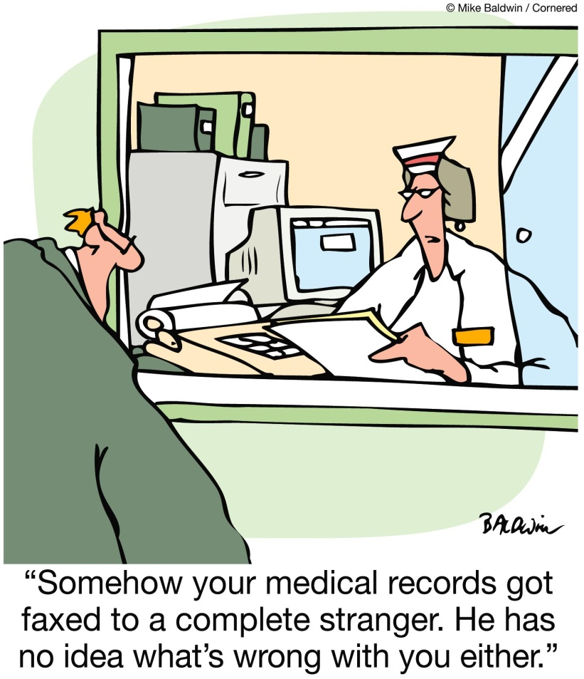
Real Life Privacy Breaches
Order #7
USB key lost by public health nurse going to flu immunization clinic
More than 80,000 patients affected
See order #4
“Encrypt your mobile devices: Do It Now”
“Strong encryption”

Slide 44
Real Life Privacy Breaches
Order #8 – But it happened again
Stolen laptop – not encrypted
More than 20,000 patients affected
Incident reports, operating room lists, research data sets, class lists for patient education sessions (no health numbers or patient addresses)
See orders #4 and #7
Corporate policy re mobile devices
Training
Encryption

Slide 45
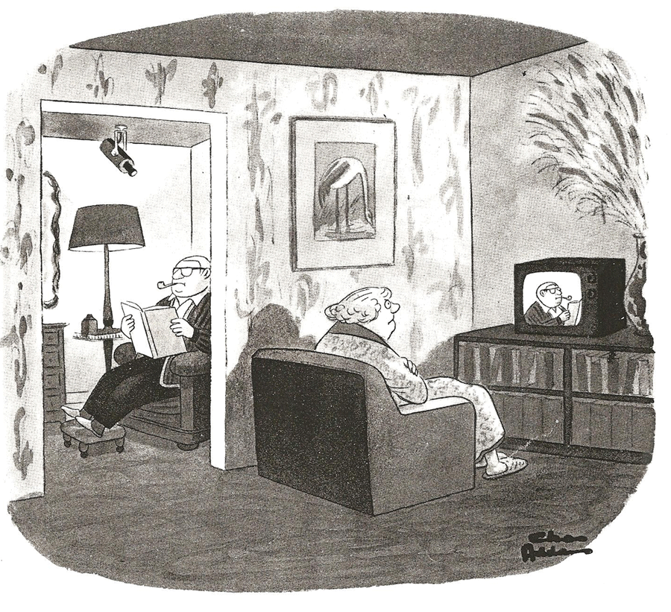
Real Life Privacy Breaches
Order #5 – Wireless camera in bathroom of methadone clinic
If using wireless technologies, must be scrambled or encrypted
Review practices and technologies regularly
IPC fact sheet on wireless technologies released

Slide 46
Access and Correction

Slide 47
Real Life Privacy Breaches
Order #9 – Fees charged to access health records must be reasonable
Physician could only charge $33.50 not $125 for 34 pages of psychological therapy notes
Not cost recovery
There are draft fee regulations – those should be followed

Slide 48
Real Life Privacy Breaches
Order #12 – Organization refused patient access to health record (deemed refusal)
Must respond to requests for access to health records within 30 days

Slide 49
Real Life Privacy Breaches
Order #14 – Fees charged to access health records must be reasonable
London Health Sciences charged $117 to a lawyer
$117 was above and beyond “reasonable cost recovery”
Could only charge $53
$30 to process the request + copies of the first 20 pages
+ $0.25/page for the remainder

Slide 50
Real Life Privacy Breaches
Decision #15
Psychologist providing an assessment for a Custody and Access Assessment Report
One parent wanted psychologist to “correct” report
Held: Psychologist was NOT a HIC for the purposes of this report and did not have to correct it b/c obligations of a HIC did not apply
A regulated health professional who is not providing health care to a client is not a HIC for the purposes of PHIPA
Hooper v. College of Nurses of Ontario + Wyndowe v. Rousseau

Slide 51
Real Life Privacy Breaches
Decision #17
FIPPA and PHIPA
Mackenzie Health (formerly York Central Hospital)
An infant died shortly after birth – husband/father asked for records
Raises issues of the interplay between FIPPA and PHIPA
What is “personal health information”?
Under what circumstances can organizations not disclose records to a requester?
What does it mean if you are subject to FIPPA and PHIPA? (like hospitals)
What does it mean if you are only subject to PHIPA?

Slide 52
Real Life Privacy Breaches
Decision #18
Sensenbrenner Hospital
A mother asked for her son’s records after he died in a fatal car accident
She believed the hospital should have more records than she was given
What constitutes a “reasonable search”?
IPC dismissed the complaint and said hospital did a reasonable search

Slide 53
Disclosure of Deceased Person’s Records to Someone Other than Estate Trustee

Slide 54
Real Life Privacy Breaches
4 new decisions released
Generally about family members who wish to have information about deceased persons (and estate trustees refused to share info)
HICs must consider whether to exercise their discretion to disclose under s. 38(4)(b) or (c)
IPC cannot require the disclosure – but can order HICs to consider and ensure HICs only contemplating relevant factors in their decision making

Slide 55
Real Life Privacy Breaches
s. 38(4) A HIC may disclose PHI about an individual who is deceased, or is reasonably suspected to be deceased:
For the purpose of identifying the individual
For the purpose of informing any person whom it is reasonable to inform in the circumstances of:
The fact that the individual is deceased or suspected to be deceased and
The circumstances of death where appropriate
To the spouse, partner, sibling or child of the individual if the recipients of the information reasonably require the information to make decisions about their own health care or their children’s health care

Slide 56
Social Media

Slide 57
Real Life Breaches
Ontario arbitration Credit Valley Hospital 2012 (Brathwaite)
Employee posted pictures on Facebook of a patient who committed suicide in a hospital parking lot (age and location of patient were revealed in the posting)
Should have known possibility that it was a patient (even though off site)
Employee was not remorseful
Not a momentary lapse in judgment - time elapsed between the posting of the two photos, and then the related commentary
Deterrence message was important

Slide 58
Real Life Breaches
Chatham-Kent v. CAW 2007
Employee blogged about nursing home residents and co-workers
Only used first names but pictures of staff and residents were uploaded
Employee worked at the facility for 8 years, she apologized but she was terminated and that decision was upheld by an arbitrator
The arbitrator found that the postings amounted to insolence and a grave breach of confidentiality

Slide 59
Privacy Training for Staff
Am I allowed to leave a voice message for patients with health information?
Can a patient’s spouse make an appointment over the phone?
Do I have to share information with a teenager’s parents? Am I allowed? What age can kids make their own decisions about their information?
What do we do when staff are patients here?
Are we allowed to look at our own health records? What about our children’s health records?

Slide 60
Privacy Training for Staff
What do I do when a patient of the FHT comes up to me at the grocery store?
Can I give specialists and diagnostic services appointment information?
Can I give PHI in response to letters from lawyers, criminal investigations, insurance companies?
Do I have to give copies of tests and results and consult notes to patients at the end of their appointment?
What is the circle of care? Are we allowed to share information with the hospital? School? CAS? Police? HealthLinks?

Slide 61
Privacy Training for Staff
Is it a breach if someone overhears another person’s health information (like diagnosis)?
Should we have privacy windows that slide in reception?
Should staff use patient numbers instead of patient names when calling into a room?
Can support staff scan reports for urgent results?
Can we use email to communicate with patients/other health care providers? (text message?)

Slide 62
Privacy Resources
Association of Family Health Teams of Ontario
Privacy Toolkit for the Quality Improvement Decision Support Program in Family Health Teams
Statutory Compliance Toolkit for Boards of Family Health Teams and Nurse Practitioner-Led Clinics
Top 5 Privacy Questions Answered with 5 Privacy Tools

Slide 63
Privacy Resources
Information and Privacy Commissioner of Ontario
45 Minute PHIPA Training Video for all health sector staff
PHIPA Fact Sheets
PHIPA Orders
College of Physicians and Surgeons of Ontario
Confidentiality of Personal Health Information
Medical Records
Appropriate Use of Social Media by Physicians
College of Nurses of Ontario
Confidentiality and Privacy – Personal Health Information
Social Media

Slide 64
Privacy Resources
Canadian Medical Protective Association
Privacy and Confidentiality
Documentation
Ontario Hospital Association and Ontario Medical Association
Hospital Privacy Toolkit
OntarioMD
Privacy & Encryption Online Tutorial
DDO Health Law
3 day Privacy Officer Training for the Health Sector
3 hour Privacy Training for Family Health Teams
1 hour Privacy Training for the Health Sector (online streaming video) – Coming March 2016
Legal Issues for Family Health Teams Monthly Teleconference

Slide 65
Privacy Training for FHT Boards
Kate Dewhirst
kdewhirst@ddohealthlaw.com
Follow me on Twitter: @katedewhirst
Check out our website and blog: www.ddohealthlaw.com
Coming soon (March 2016):
www.thehuddleseries.com online videos

