Slide 1
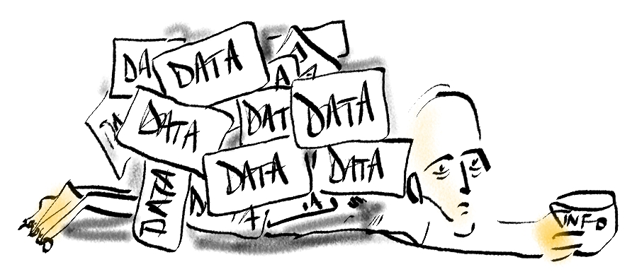
Data to Decisions:
What’s meaningful to you?

Slide 2

Why is AFHTO doing Data to Decisions (D2D) 1.0?
D2D 1.0 is a starting place for primary care measurement.
At a health team level
  As a summary report of indicators that are currently available and meaningful, it will show health teams where they stand relative to peers.
  It will help teams see and celebrate successes and point them to the next place to focus to advance quality of care in their own teams.
At the AFHTO membership level
  D2D 1.0 will demonstrate the leadership provided by team-based interprofessional primary care organizations.
  D2D 1.0 will give members an opportunity to influence the directions for measurement and quality improvement in primary care

Slide 3
How does D2D 1.0 fit with other initiatives?
D2D 1.0 builds on primary care measurement efforts such as:
  Primary Care Performance Measurement Framework (PCPMF) -- Expected completion by Health Quality Ontario (HQO ) mid-2014 (http://www.hqontario.ca/public-reporting/primary-care
  Starfield model -- Adopted by the AFHTO board http://www.afhto.ca/wp-content/uploads/Valuing-comprehensive-primary-care.pdf
  AFHTO QIDS Innovation projects: completed Mar 2014, knowledge transfer underway.
D2D 1.0 focuses on the current work in measurement that overlaps between health teams to maximize the value from existing efforts without further taxing scarce resources.

Slide 4
What is D2D 1.0?
D2D 1.0 is a summary of primary care data that are currently available, comparable and mean the most to members in their efforts to advance quality of care for their patients.
D2D 1.0 will help members
  Know where your team stands relative to your peers
  Celebrate the successes of your team
  Know where to start to advance quality of care in your health team

Slide 5
Who is participating?
Participation is limited to AFHTO members & is completely voluntary
There are many ways to participate
  Provide comments and ask questions
  Vote on indicators (open to all AFHTO members): Apr 24-May 8
  Discuss with your QIDSS: already in progress…
  Track D2D 1.0 indicators locally: test extractions after indicators are selected
  Contribute your data to D2D 1.0: after you review your test extracts (if any)
  Plan for D2D 2.0: any time
Members decide what level of participation works for their team

Slide 6
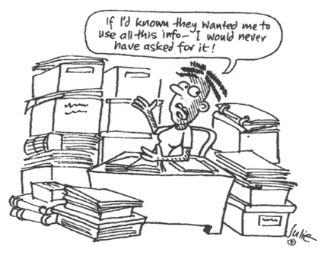
How much work will D2D 1.0 be?
D2D 1.0 will only include data that are already available
Health teams decide how much effort they can afford to contribute to the project (see different ways of participating)
The focus of D2D 1.0 is on the areas where the collective efforts between health teams overlap so everyone can get more value out of this work

Slide 7
When is the D2D 1.0 project happening ?
When did the project start?
  AFHTO Board approval Feb 2014 -- introduced to members March 2014
When will production of the D2D 1.0 report start?
  Deadline for contribution of data is Jul 15, 2014
When will D2D 1.0 be done?
  D2D 1.0 will be released by the annual AFHTO conference, Oct 15-16, 2014

Slide 8
How were indicators selected?
Stage 1: The baseline for consideration was presence in the PCPMF or Starfield model.
Stage 2: The first selection stage included indicators that were already in at least one existing multi-team reporting process or tool (see the data dictionary for more details on sources).
Stage 3: The “long list” of indicators from stage 2 was sorted based on input from QIDSS and the Indicators Working Group, resulting in a list of 43 indicators.
Stage 4: The QIDSS voted to indicate their perceptions on the availability of data for and interest among their health teams in the indicators.
Stage 5: One of 6 innovation projects funded by AFHTO identified primary care performance measurement areas/topics of interest to physicians. Although it took a different format from the QIDSS survey, it yielded similar types of information.
Stage 6: On review of the QIDSS vote and the physician survey, the IWG recommended a shorter list of 26 indicators for membership voting.
Stage 7: Membership-wide vote on 26 indicators, providing input on interest (as measured by current use) and availability of data for the indicators.
Stage 8: Final review by IWG to ensure alignment with the Starfield philosophy of primary care and balance between patient-derived data (ie via surveys) and so-called “objective” data from provider data sources such as EMR.

Slide 9
How was the list of indicators finalized?
Indicators Working Group recommendation to QIDS Steering Committee
Criteria for final list
  Meaningful: AFHTO members vote, previous votes, innovation project results, PCPMF, external partners etc
  Available: successful “test” extractions May-June, QIDSS input
  Breadth: based on # of teams contributing data by Jul 15, 2014
Notes:
carol

Slide 10
Who will help extract &/or contribute data?
QIDSS will be available to partnerships and will help via
  Their day job! Daily efforts to support Quality Improvement
  Responding to needs of health teams for data
  Collaborating with peers (via QIDSS forums)
  Accessing support from EMR vendors through Communities of Practice
  Seeking/receiving guidance from Vendor/Supply Chain of QIDS Steering Ctte
Help for AFHTO members not currently part of a QIDSS partnership
  AFHTO QIDS program staff
  Fellow AFHTO members

Slide 11
When I submit our data, who will see it?
All health-team level data will be anonymized in D2D 1.0
  Only you and report production staff will know which data is yours.
PRIVACY
  There is no information that identifies patients so no risk of breach of private health information.
CONFIDENTIALITY
  There is no information that identifies health teams so no risk of breach of confidential information
OntarioMD is the production partner
  The anonymous, de-identified data submitted by health teams will be compiled into a final report by OntarioMD, as part of their ongoing engagement with AFHTO’s efforts to improve use of EMRs and data for primary care performance measurement

Slide 12
For more information
  D2D 1.0 FAQ: http://www.afhto.ca/wp-content/uploads/Frequently-Asked-Questions-about-D2D-1-0-Advancing-primary-care.pdf
D2D 1.0 data contribution: http://www.afhto.ca/members-only/library/member-news/data-to-decisions-d2d-1-0-introducing-the-final-list-of-indicators/
Carol Mulder, Provincial Lead, QIDS program carol.mulder@afhto.ca

