Slide 1
Integrating Caregivers as Partners in Care:
Momentum for a Whole-System Approach

Slide 2
Trigger Warning
This conversation mentions the topic of suicide
If you or someone you know is in crisis,
please reach out to the new
9-8-8 Canada Suicide Crisis Helpline
or mental health professional

Slide 3

Remembering Torrance
1987 - 2024

Slide 4
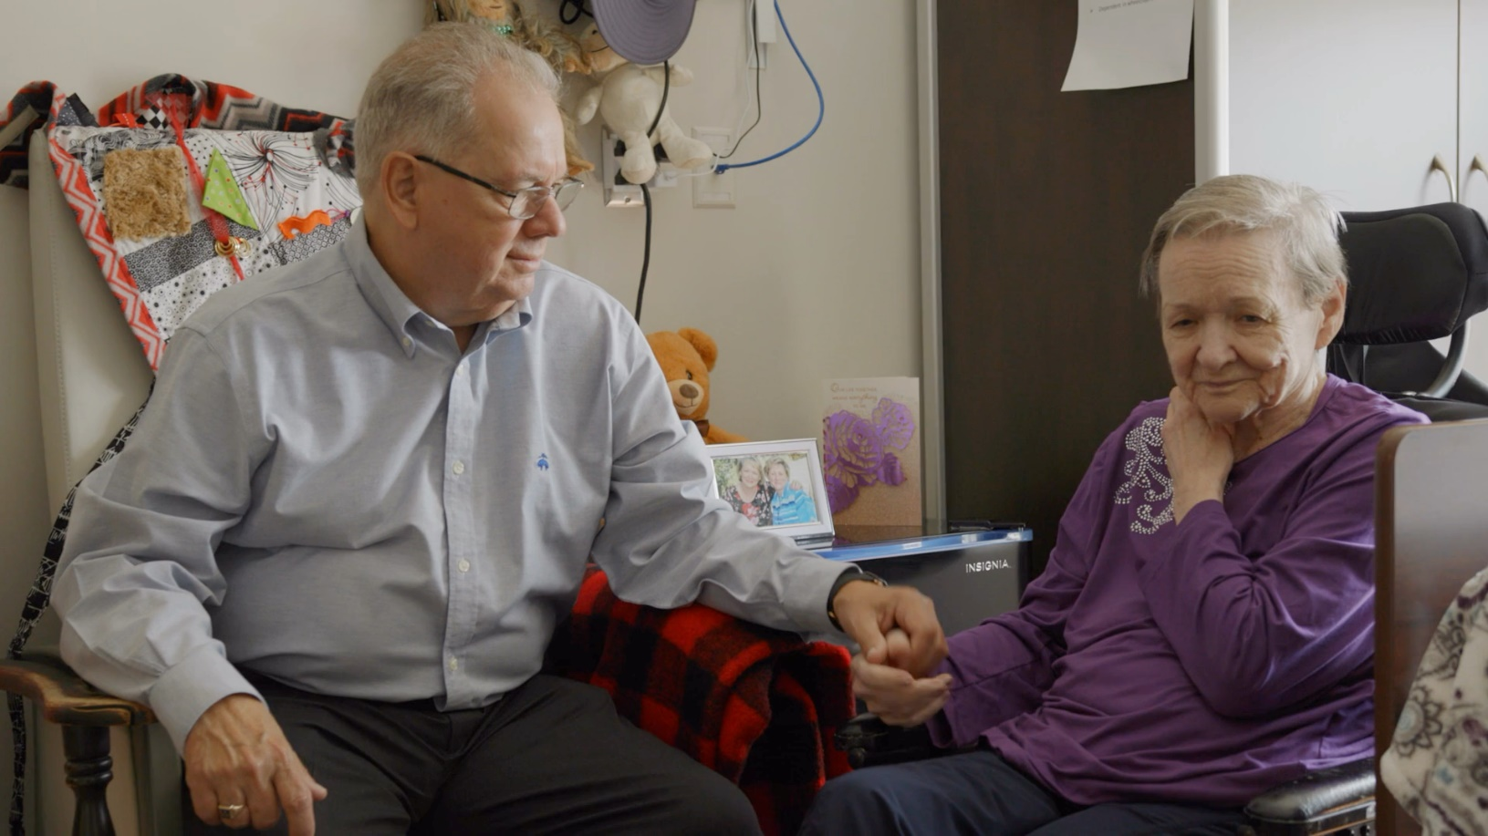
Caregivers Are Essential
CarCaregivers Are Essentialegivers Are Essential

Slide 5
So Where Do We Start?
    Simple things we can all do to make a difference right away
    Demonstrate Leadership
    Acknowledge and Validate Caregivers
    Listen to Understand and Seek Opportunities to Learn
    Commit to Long Term Change
    Learn more about the ECP Support Hub and How It Can Support Your Organization ontariocaregiver.ca/essentialcarepartner

