Slide 1


Slide 2
Objectives
The objectives of this presentation are to:
Illustrate the current impact of CMA’s decision to cease including important tools and resources as a CMA member benefit on physicians.
Offer CPS as a potentially cost-effective solution to assist in therapeutic and drug information knowledge transfer and reduce the administrative burden for medical and pharmacy teams regarding prescription clarification.
Reintroduce CPS in its new format for consideration for AFHTO Members to adopt CPS Full Access as a needed resource for HCPs to carry out patient care via an AFHTO member benefit.

Slide 3
The Reach of and Current Impact for Community Physicians
With the cease of CMA offerings, there are a number of physicians now without resources.
CPS is available in most hospitals and academic institutions.
Community physicians have been impacted and are looking for solutions.
Approx 80K Physicians had CPS Full Access as a CMA member benefit up until June 28, 2023.
500 Hospitals in Canada use CPS
26,000 Pharmacists in Canada use CPS
40,000 Medical and Pharmacy students
and residents start their education with CPS
Notes:
As of July 2022
There are currently 1,465 manufacturer product monographs and close to 400 products called generic listings in CPS Online English (generic listings include multi-source molecules). Total would be the same for CPS Online French.
2022 Web and mobile combined page views are 6,841289 (web 6,442,703 mobile 398,586)
The total represents over 4,000 DINs in CPS Online.

Slide 4
Feedback from Physicians re: CMA Decision
The CPS Client Experience team fielded many complaints from community physicians who don’t have access to existing institutional (academic/hospital) CPS Full Access subscriptions.
Most physicians with access to institutional CPS subscriptions are unaware of how to access and/or are hesitant to use the services because they either have to use it onsite or connect their computer to a secure portal.

Slide 5
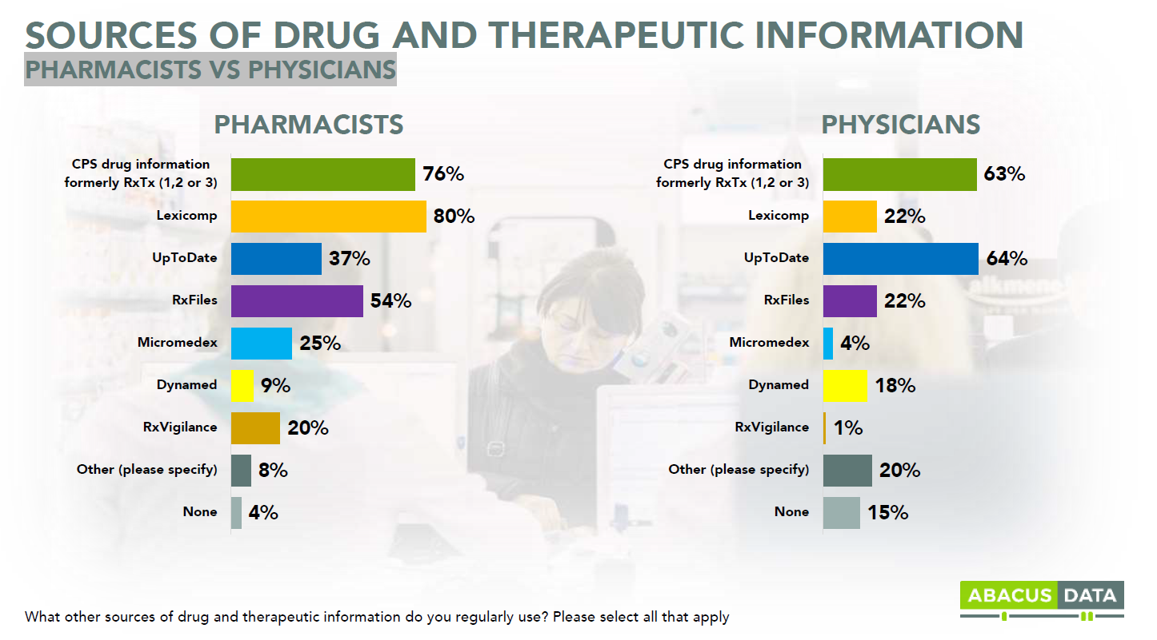
What is Being Used? 2021 Survey Results

Slide 6
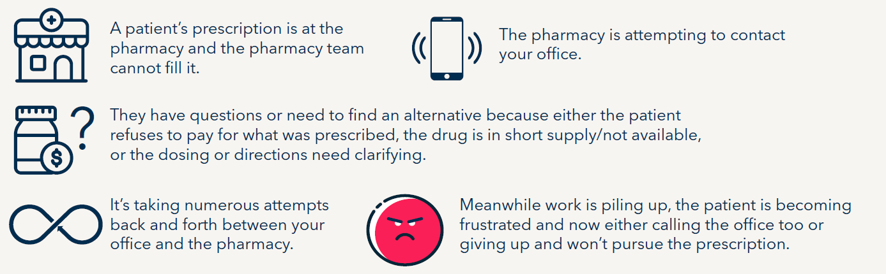
What was Learned from FMF 2022
The majority of HCPs are using more expensive US-based resources which can at times, lead to prescriptions being written incorrectly and burdening admin for clarity.
Christopher J Edwards Vivienne Ng , Nicholas B Hurst , Juan Contreras , Farshad Mazda Shirazi J Emerg Med 2022 Jun;62(6):783-788. doi: 10.1016/j.jemermed.2022.01.005. Epub 2022 Mar 13.
Laura B Hansen, Douglas Fernald, Rodrigo Araya-Guerra, John M Westfall, David West, Wilson PaceJ Am Board Fam Med 2006 Jan-Feb;19(1):24-30. doi: 10.3122/jabfm.19.1.24.

Slide 7
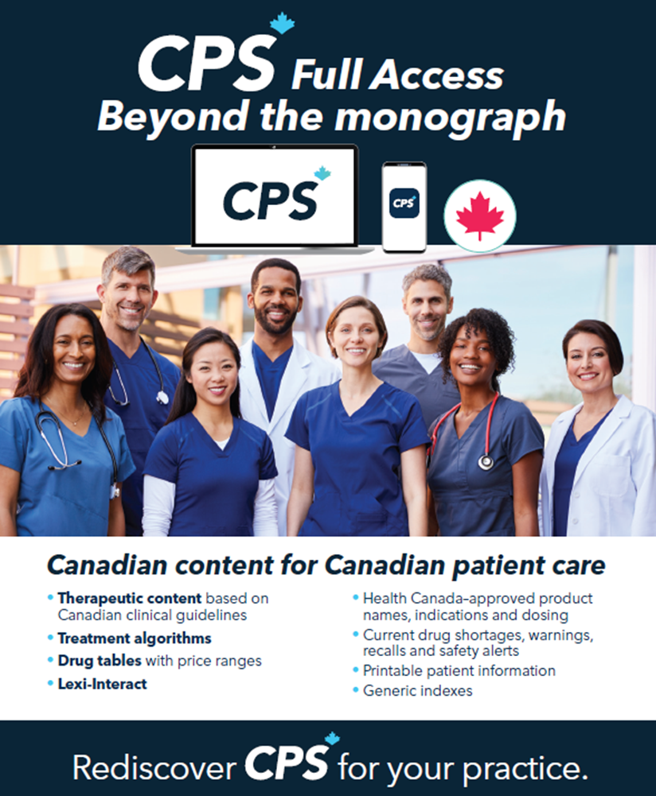
CPS Has Evolved Significantly – Canadian Content for Canadian Patient Care
CPS is remembered as the ‘big blue book’ of product monographs.
2022 marked the last print edition of the former blue book.
Now there are two different online subscription models for CPS.
CPS Drug Information – which is pretty much what the ‘big blue book’ used to be/mainly product monographs.
CPS Full Access (formerly known as eCPS/RxTx) – includes our other publications – specifically ‘Therapeutic Choices’.

Slide 8


CPS is Available in French and English
Users can set their preferred language and toggle between either languages depending on their needs.
I.e.. Printing patient medical / medication information.

Slide 9
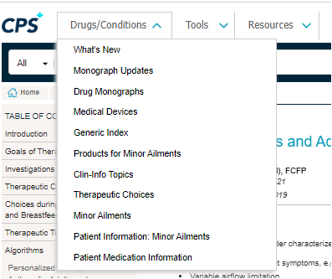
CPS Full Access - Drop Down Menu

Slide 10
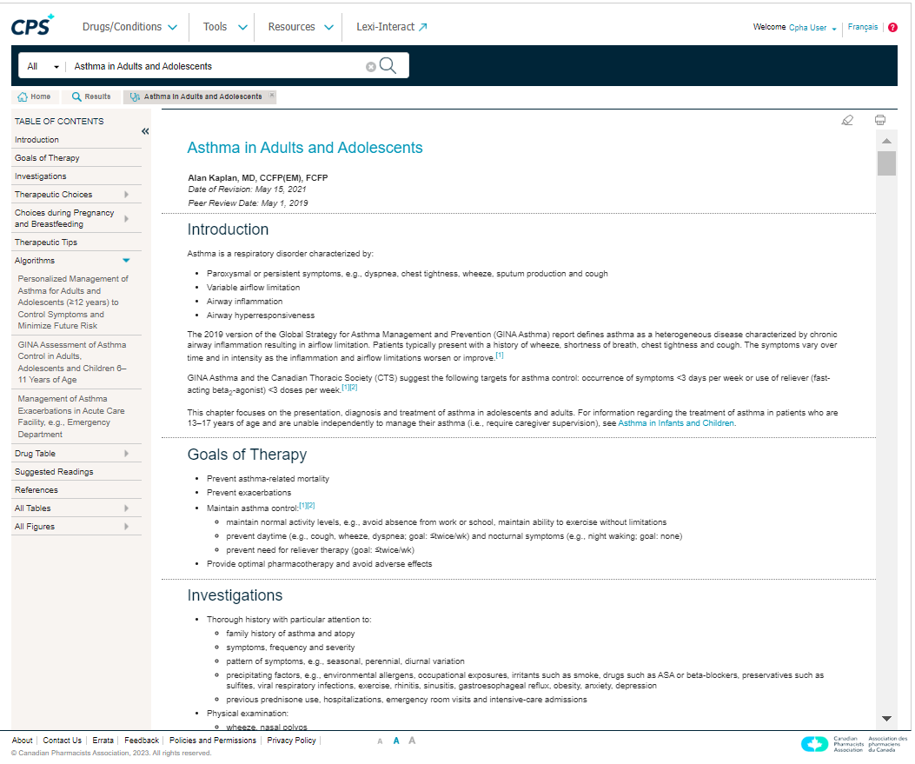
CPS Content Has Evolved Significantly
CPS Full Access contains peer-reviewed therapeutic chapters written by Canadian HCPs and based on Canadian CPGs.
Each chapter’s table of contents gives a full pathway logic of assessment to treatment as well as patient information / additional resources.
The table of contents for each therapeutic chapter, includes:
Goals of therapy
How a patient may present
Investigations
Dx/Tx algorithms
Considerations in pregnancy and breastfeeding
Therapy (non-pharmacologic and pharmacologic)
Drug tables with pricing – some product names are linked to product monographs
Additional references, patient information, and resources.

Slide 11
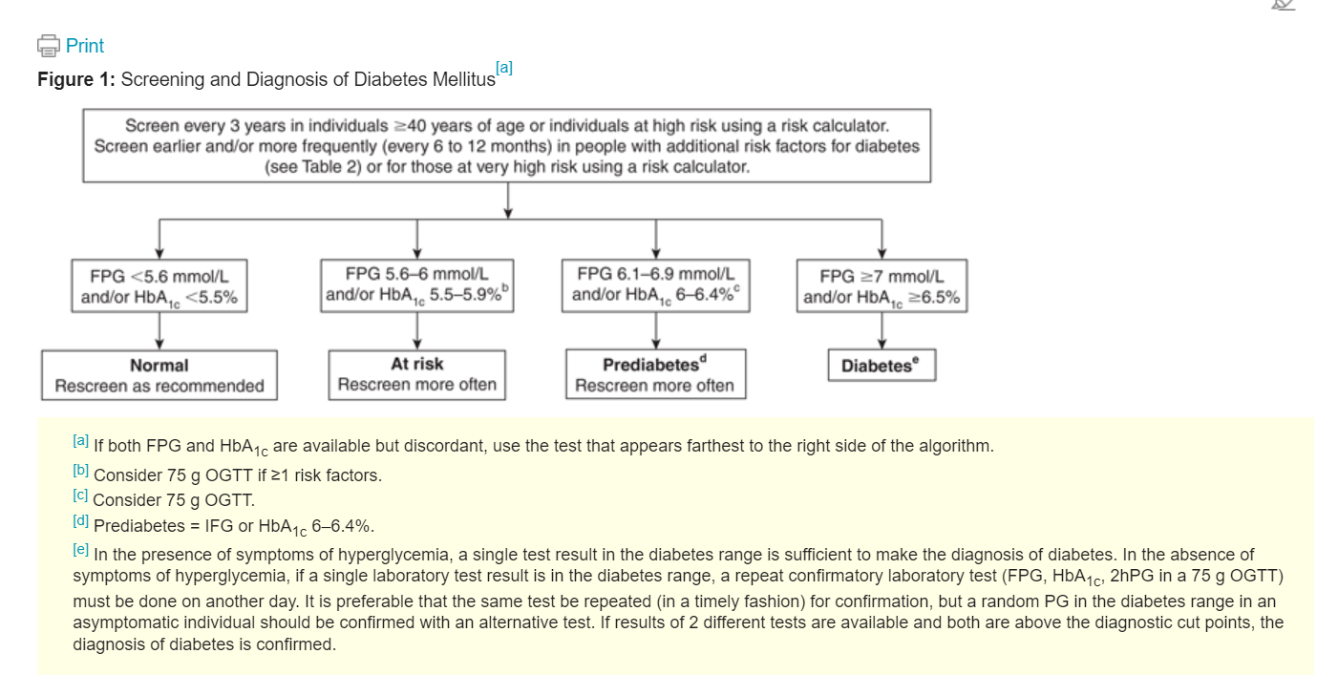
Example of a Dx Algorithm in a Therapeutic Chapter

Slide 12
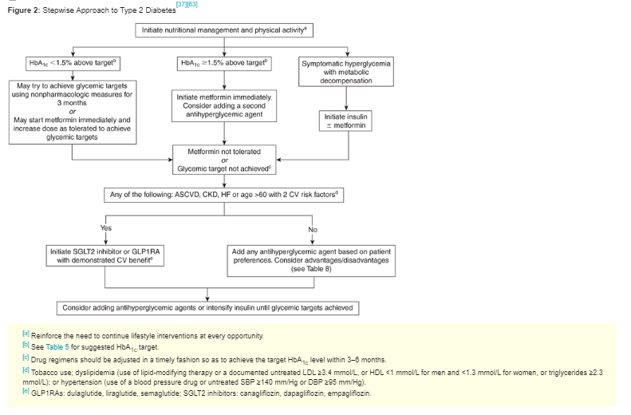
Example of a Tx Algorithm in a Therapeutic Chapter

Slide 13
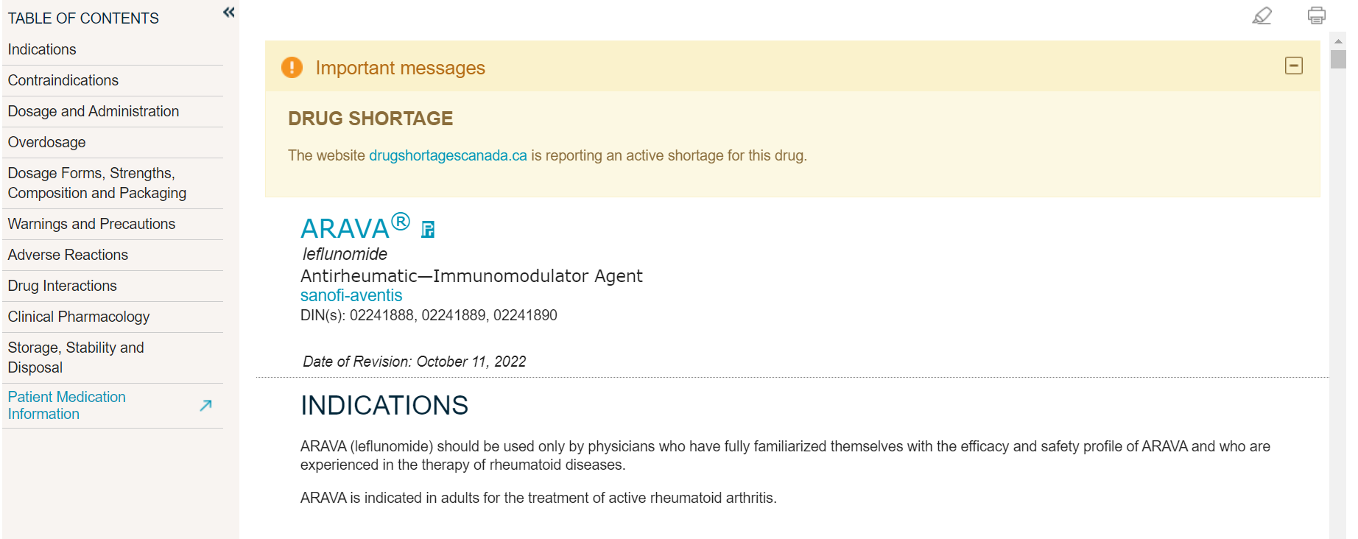
Save Time Rewriting Prescriptions – CPS Offers Drug Shortages/Warnings Per Monograph
CPS is linked to the Health Canada Drug Database.
When product monographs are viewed, a prescriber can see if the product is readily available / has warnings.

Slide 14
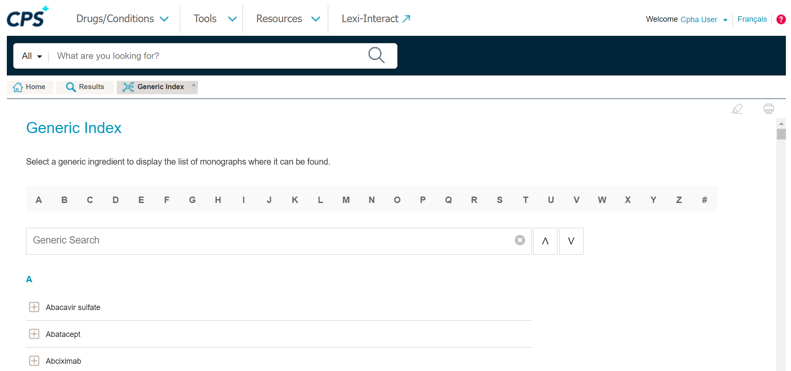
CPS Full Access – Generic Index
The generic index can be used when choosing an alternative treatment during times of shortages/
discontinuations– example ARBs a few years ago.

Slide 15
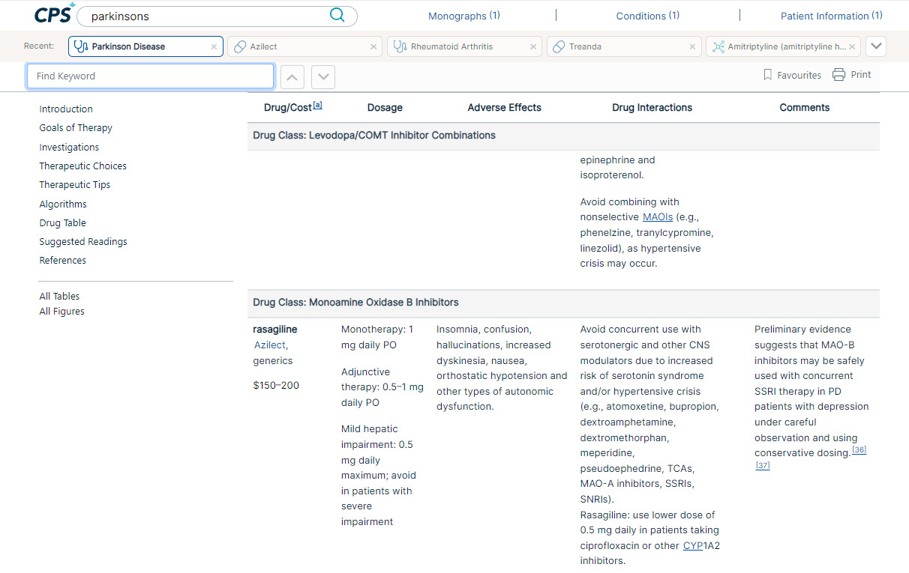
CPS Full Access – Drug Tables with Pricing
Drug tables can also be used when choosing an alternative treatment and is listed by drug class.
Find a treatment option, view pricing, and then link back to monograph.

Slide 16
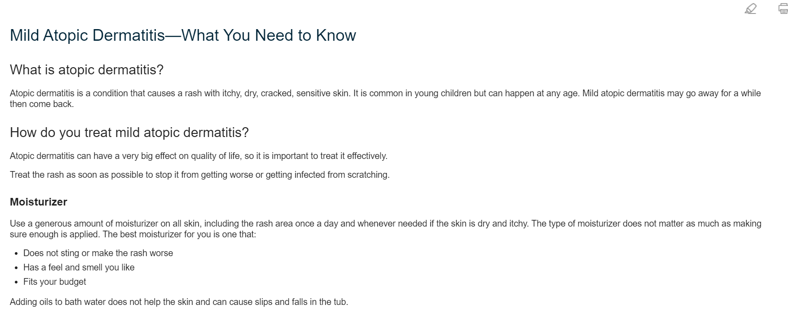
Print/Provide Patient Medical Information

Slide 17
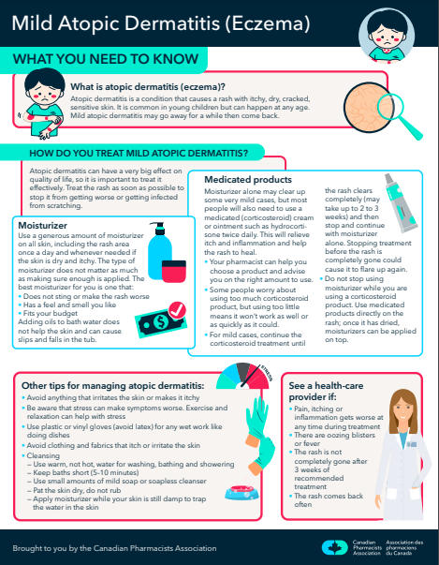
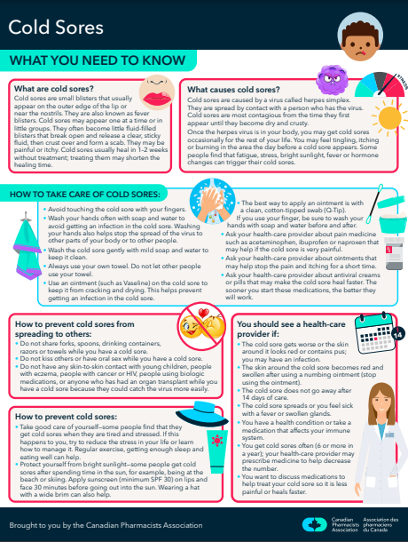
Patient Infographics – Now Available for Some Conditions

Slide 18
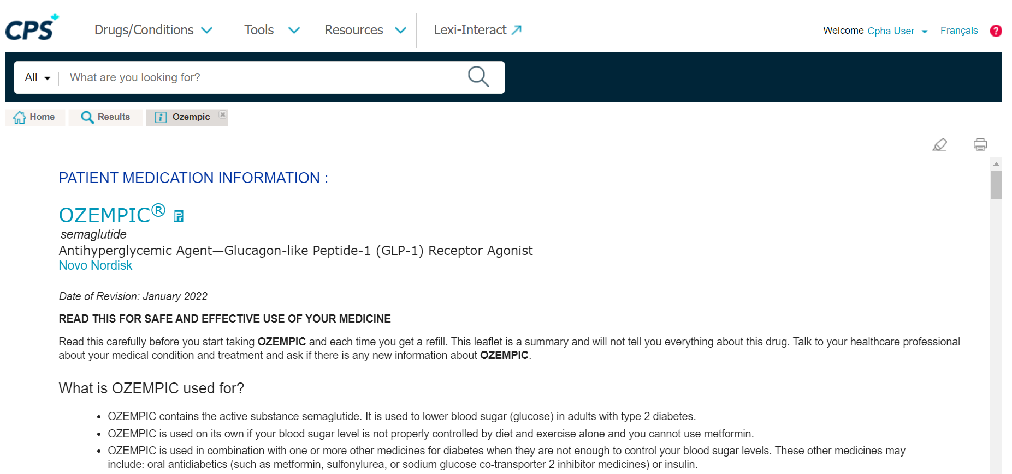
Print/Provide Patient Medication Information – Health Canada Approved
Printing
capabilities

Slide 19
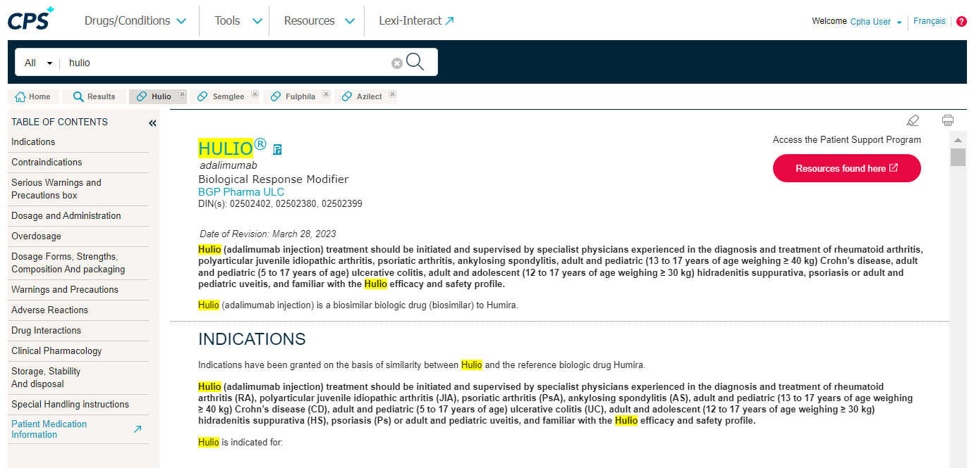
Access Additional Resources like Patient Support Program/Financial Assistance Programs
This feature is available on a few select products. This is at the manufacturer’s discretion and is not available for all product monographs.

Slide 20
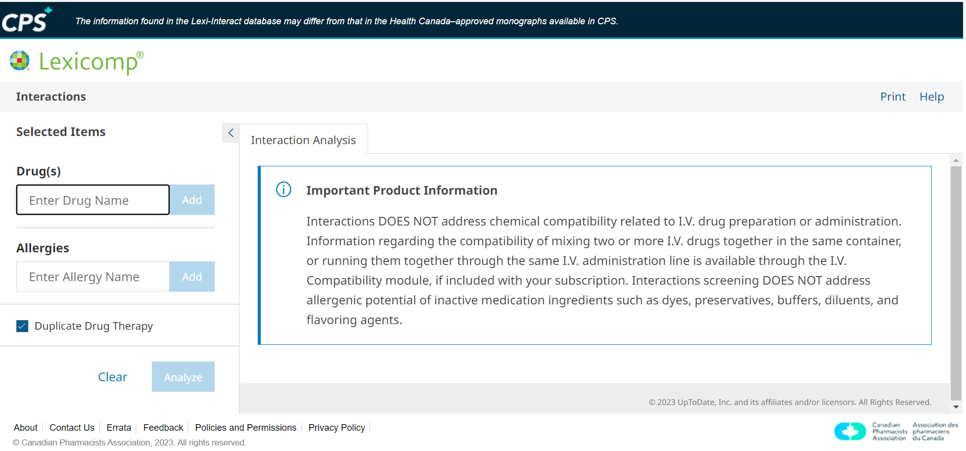
Lexi Interaction Checker is Included in All Subscriptions

Slide 21
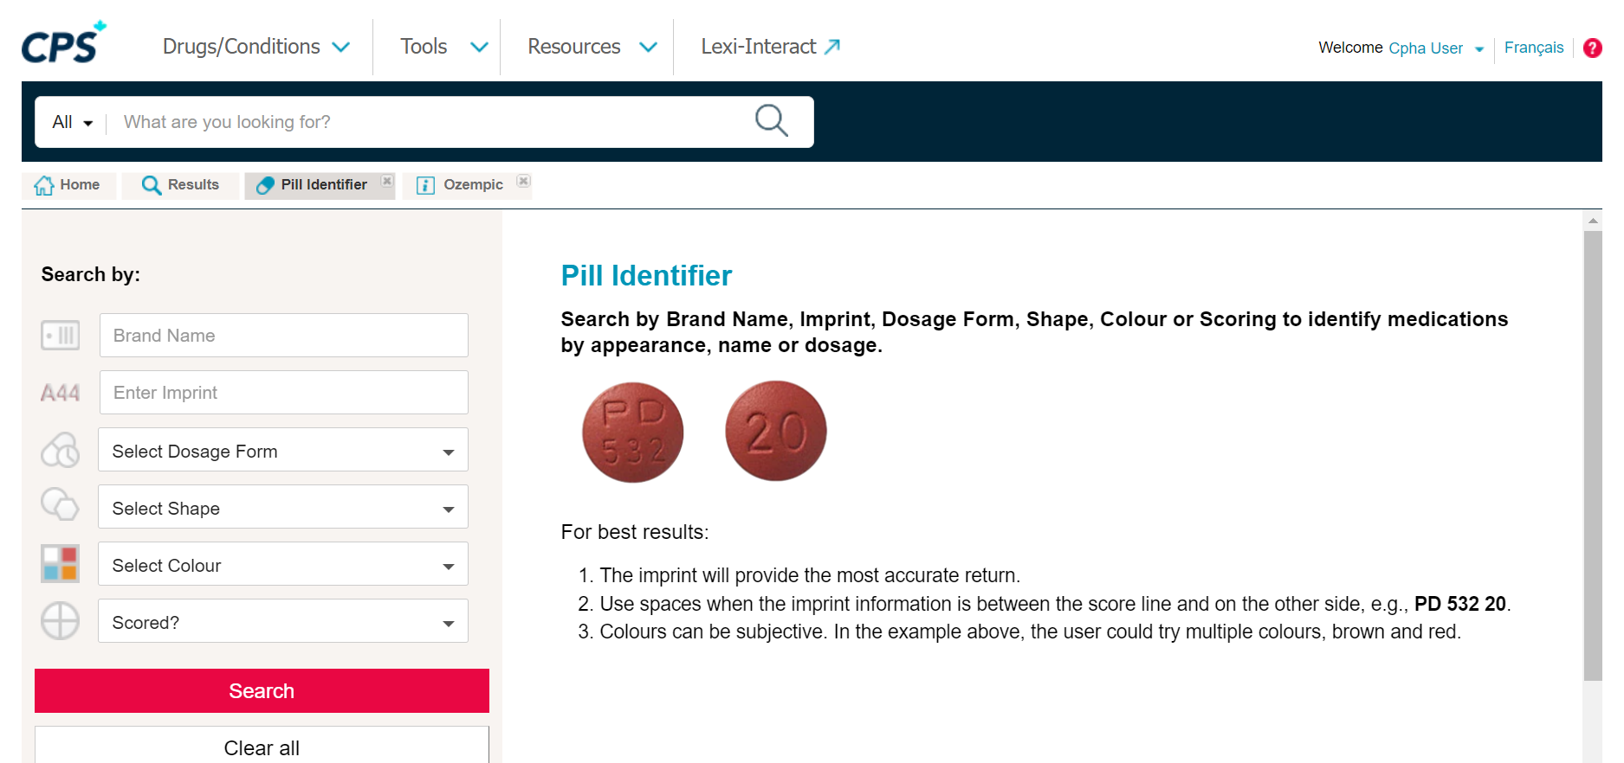
CPS Includes Pill Identifier Tool

Slide 22
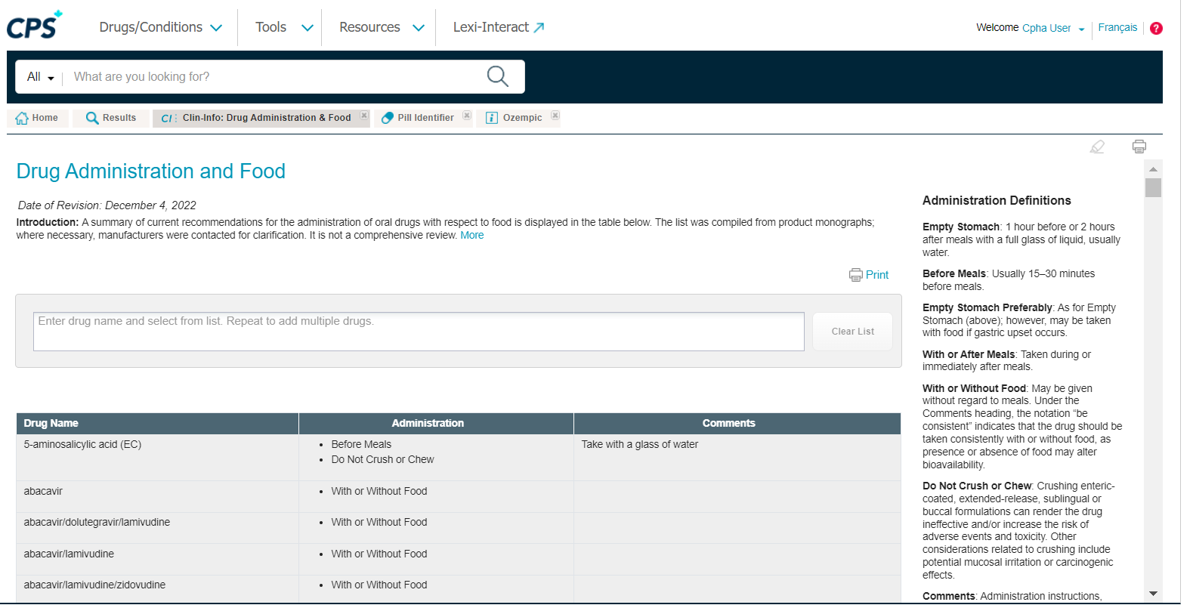
CPS Includes Drug Administration and Food Look Ups

Slide 23
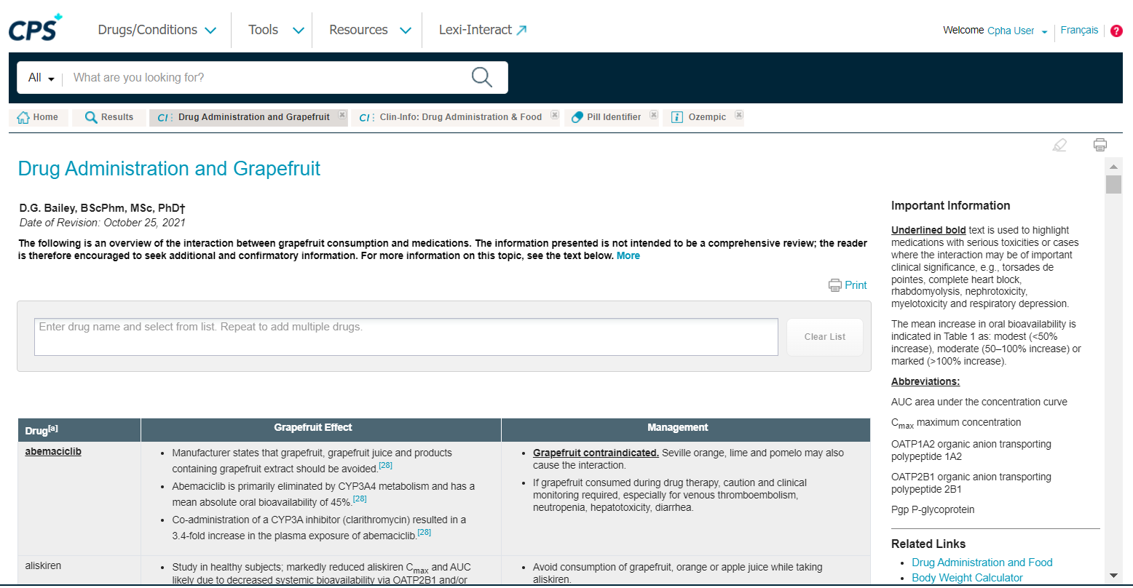
CPS Includes Drug Administration and Grapefruit Lookups

Slide 24

Link CPS to Other Systems
Partial Integration/Link
Link your EMR/EHR to CPS content to assist with the completion of fields within electronic records

Slide 25
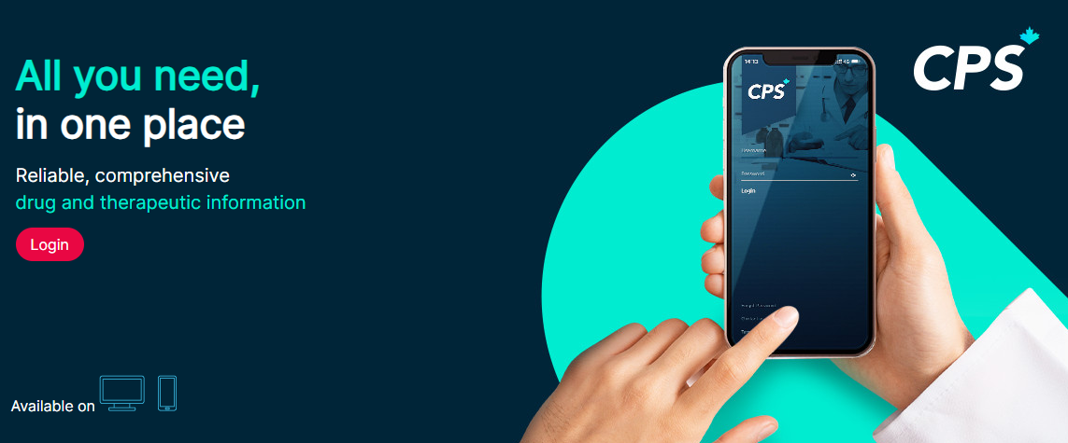
CPS Access on Different Devices

Slide 26
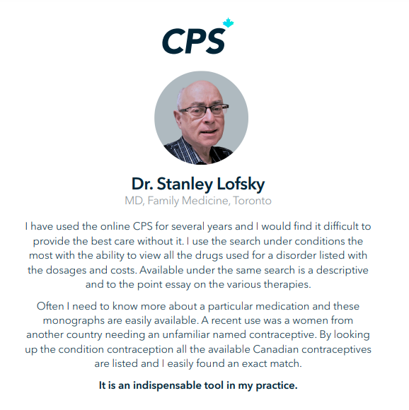

Testimonials
I have used and enjoyed CPS on my smartphone from the day it was launched. It has provided me with ready access to all Canadian drug monographs without worrying about US content.
It is well organized and easy to access, especially during busy workdays at the office for immediate point-of-care access. Adult and pediatric dosages are well organized with readily available resources like dosage calculators.
I do not miss the old, fat CPS book. I use my CPS app on my smartphone on a daily basis, which facilitates rapid access to changing drug monographs.
Dr. Shahzad Bhatty MD CCFP FCFP
Medical Director, Phoenix Healthcare Center

Slide 27
International Medical Graduate Partnership
MedSckool Reviews is reaffirming its commitment to providing comprehensive resources and tools to students pursuing excellence in their medical careers. The inclusion of CPhA's CPS Full Access software in MedSckool Reviews' offerings will empower aspiring physicians with a wide range of invaluable resources and information.
Key features of CPS Full Access software include:
1. Patient Assessment and Treatment Algorithms: Detailed step-by-step algorithms to guide medical professionals in diagnosing and treating various conditions.
2. Pharmacologic Therapy Options and Drug Tables: A comprehensive database of pharmaceutical information, including dosages, indications, contraindications, and potential adverse effects.
3. Nonpharmacologic Therapy Options: Insights into non-drug treatment modalities to consider for optimal patient care.
4. Monitoring of Therapy Information: Guidelines and tools for monitoring patient progress and adjusting treatment plans as needed.
5. Prevention Strategies: Evidence-based recommendations for preventive healthcare measures.
6. Information for Patient Handouts: Educational materials to help physicians effectively communicate important health information to patients.
This collaboration between MedSckool Reviews and the Canadian Pharmacists Association aims to bridge the gap between medical education and pharmacy practice. By leveraging the expertise and resources of both organizations, this partnership will empower aspiring physicians to make informed treatment decisions, improve patient outcomes, and enhance the overall quality of healthcare as it relates to their licensing examinations.
Mark Mauleesan, MD MBA - CEO, MedSckool Reviews

Slide 28

For more information, go to
https://www.pharmacists.ca/products-services/afhto/
Or contact
Jody Franklin jfranklin@pharmacists.ca

