Slide 1
WDGPH Updates
Oct 1, 2020
Marlene Jantzi-Bauman RN, MPH, BScN, CIC
Liaison Section Chief, COVID-19 Response
Program Manager, Control of Infectious Diseases
Wellington-Dufferin-Guelph Public Health

Slide 2
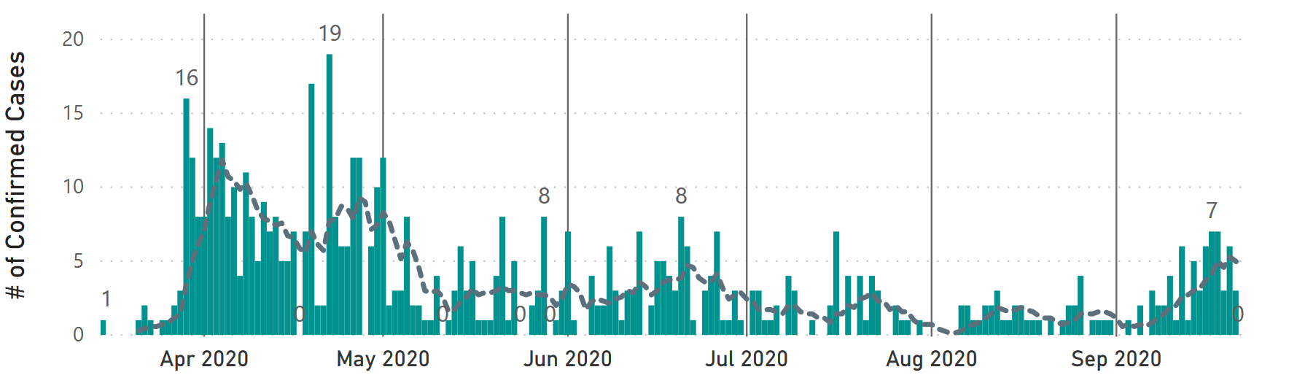
Local Epidemiology

Slide 3
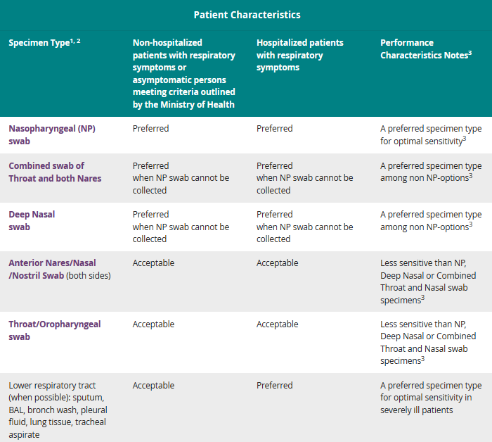
Testing
Testing recommendations & guidelines
Alternate specimen collection options
Other forms of testing in development
  Saliva
  Rapid testing
  Serology
Pharmacy testing roll-out

Slide 4
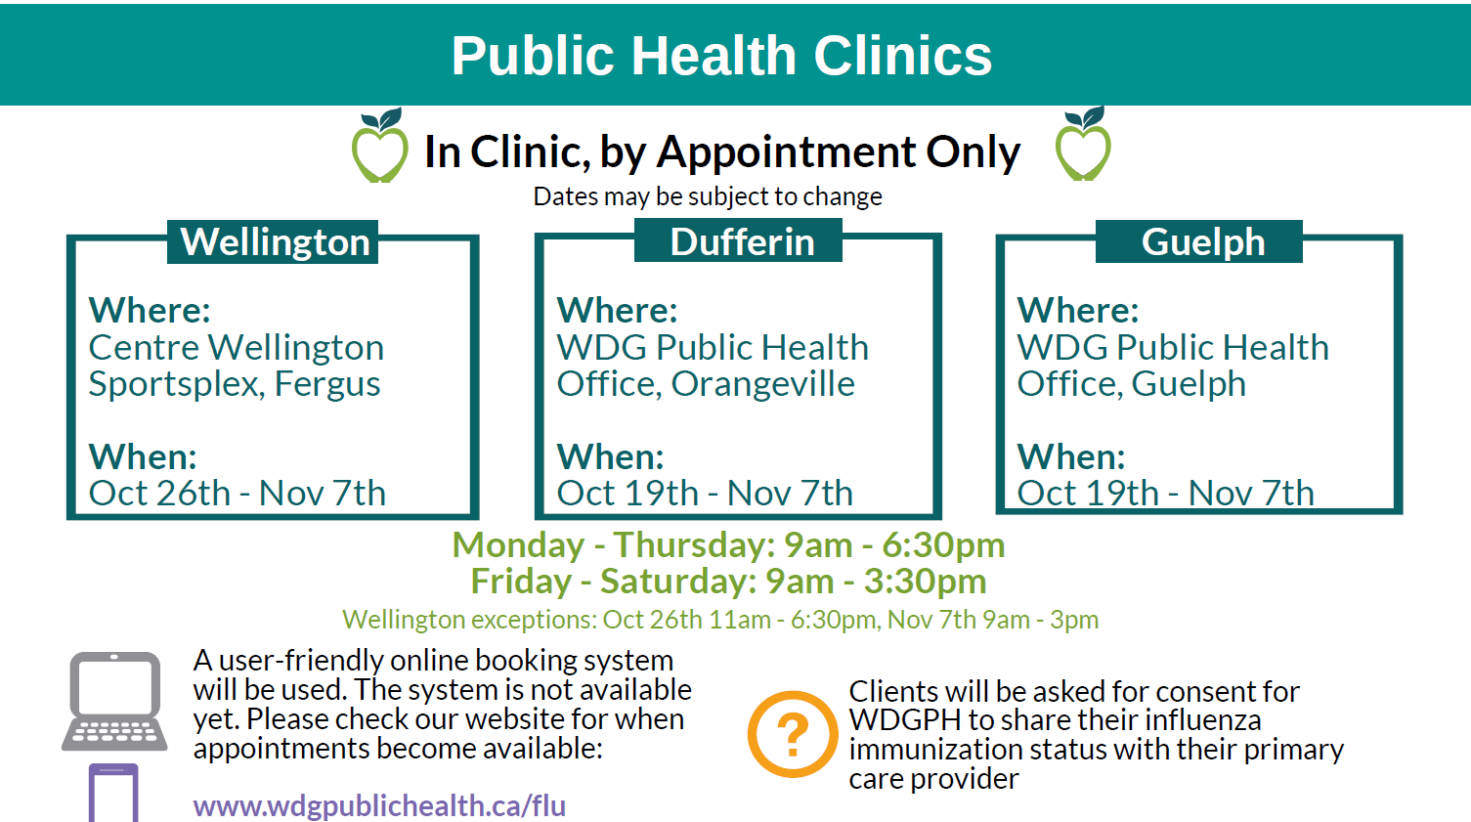
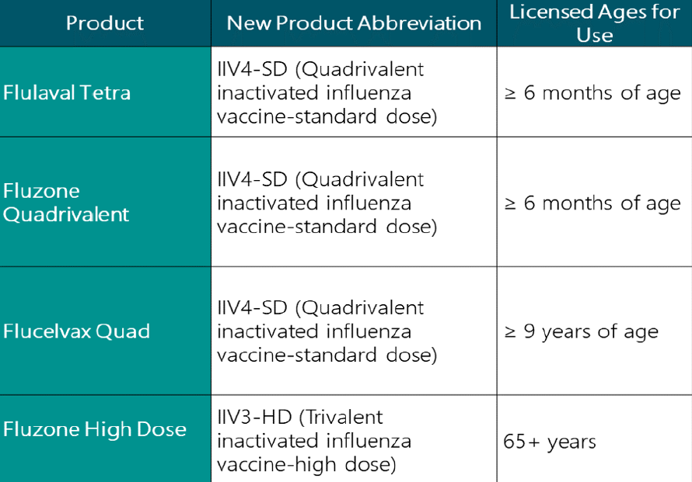
Flu Immunization

Slide 5
COVID-19 Immunization
Stage 1:
Before a vaccine is approved in Canada.
Supply procurement
Establish local COVID-19 Vaccination Planning Table(s) to determine roles and develop community immunization plan.
Stage 2:
Vaccine is approved but not yet received.
Confirmation of priority populations for vaccine allocation with Federal/Provincial governments.
Edit, refine and implement COVID-19 vaccine communication plan as more details become known.
Stage 3:
Vaccine is received by WDGPH and ready for use in community.
Implement plan based on vaccine quantities received.
Preliminary COVID-19 vaccine communication planning
Ongoing situational awareness
Continue to edit and refine community immunization plan as more details become known
Learning from past mass immunization events
Ongoing situational awareness

Slide 6
Questions
Thank You!

