Slide 1
Association of family health teams of Ontario
COVID-19
Jillian Fenik, RN, BScN, MHM
Assistant Vice President
Clinical Service Department
Simcoe Muskoka District Health Unit

Slide 2

Ontario health teams
Leading discussion regarding assessment centres
Leading and positioning thoughts for ILI clinics for the fall/winter
Leading discussion on influenza immunization clinics

Slide 3

Assessment centres
Volumes
Drive up/ drop-in or appointment
Team efforts – varying leads
New swab ordering process – allow time to receive
Image: pixabay.com

Slide 4
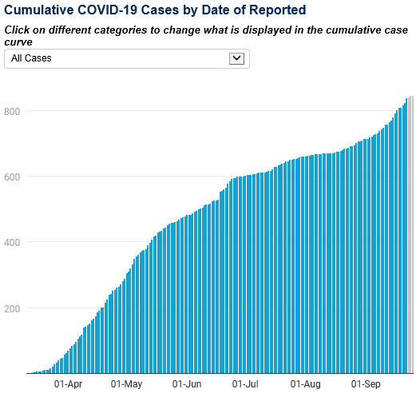
Increasing Case count
Rapid increase in cases
More contacts per case
Complexity
https://www.simcoemuskokahealthstats.org/topics/infectious-diseases/a-h/covid-19

Slide 5
IPAC REsources
1. COVID-19 Guidance: Primary Care Providers in a Community Setting: http://www.health.gov.on.ca/en/pro/programs/publichealth/coronavirus/docs/2019_primary_care_guidance.pdf
2. CPSO checklist: https://www.cpso.on.ca/CPSO/media/Documents/physician/your-practice/quality-in-practice/clinic-inspections-special-programs/ohp-ipac/ipac-checklist-covid-19-assessment.pdf
3. PHO Clinical Office Practice resources are located here: https://www.publichealthontario.ca/en/health-topics/infection-prevention-control/clinical-office-practice
Public Health Ontario - Central Region IPAC Team: IPACCENTRAL@oahpp.ca, 647-260-7560

Slide 6

schools
Prevention and preparedness
Outbreak assessment and management
  Investigate cases
  Declare an outbreak and when it’s over
  Advise on control measures, cohort(s) isolation, school closure, testing, onsite investigation and issue orders
Surveillance
  Monitor and report on cases, transmission risks and absenteeism
Coordination and Communication
  PHU of the school is the lead PHU for school follow-up in the event a case/contact resides in another region
  Assist with developing key messages and communication
Testing for affected cohorts – working with partners
Rapid Review Update 7: What is the specific role of daycares and schools in COVID-19 transmission?
Image: pixabay.com

Slide 7
Health faxes – Return to school
COVID-19: Update #21 – School and Child Care Reopening (August 20th)
COVID-19: Update #22 – School Reopening and Recommendations for Students with COVID-19 Symptoms, Updated Directives and Guidance Documents (September 2nd)
COVID-19: Update #23 – Increase in Cases and Community Transmission; Recommendations to the Public to Decrease Non-essential Social Interactions and Gatherings; School COVID-19 Update: First Confirmed Case in a School (September 16th)
Sign up to receive SMDHU health faxes: https://www.simcoemuskokahealth.org/jfy/hpportal/resourcestools/healthfax/signup
Notes:
#21 – Masking Requirement & Medical Exemptions
Communication to Parents – letter on our website
Screening and Testing
#22 – School Reopening – Outbreak Management guidance document
Screening
Symptomatic Individuals
Mask Exemptions – link to video on how to work to overcome mask anxiety
Return to School Communications – section of website
#23 – Increase in Cases and Updated Local Recommendations to the Public
First Confirmed School Case
School Specific Self-Assessment Tool Available
Resources for Parents
Household Contacts of those with symptoms

Slide 8

Flu Vaccine
Vaccine arrival
LTCH, Retirement Homes, ALC
Primary Care
Pharmacies – high dose
SMDHU clinics – under 5 and those without HCP
Storage and Handling Visits
Community Clinics - Supply
Image: pixabay.com

Slide 9
Contact Information:
Jillian Fenik
Simcoe Muskoka District Health Unit
705-721-7520 ext. 7283
705-331-5222
Jillian.Fenik@smdhu.org

Slide 10


