Slide 1




Mental Health and Addiction
QI Collaborative Webinar Series
Sandeep Gill, Clinical KTE Specialist, AFHTO
Laura Daly-Trottier, QI Coach
Ashley Koster, Program Manager
January 14, 2020
Notes:
Hello everyone,
Welcome to the Mental Health and Addiction QI Collaborative Webinar presented by AFHTO, AMHO and CMHA Ontario Branch.
My name is Sandeep Gill and I am the Clinical KTE specialist at the Association of Family Health Teams of Ontario.
We are happy you can all join us today, we have a jam packed hour today, so we will get started.
Questions will be addressed at the end of each presentation. Today we have two presentations by …….

Slide 2
Objectives of Part 2 of the Webinar Series
Share opportunities for collaboration with local mental health and addiction agencies and how to implement quality improvement initiatives.
To highlight examples of mental health and addiction quality improvement initiatives in Ontario
Listen to the Part 1 of the webinar series

Slide 3

Opioid Stewardship: Implementing Pharmacist-Led Assessments for Patients Co-Prescribed Opioids and Benzodiazepines at an Academic Family Health Team
T. Tilli, T. Kiran, N. Dewhurst, J. Hunchuck
St. Michael’s Hospital Academic Family Health Team
Notes:
Instructions for converting this PowerPoint presentation into a large format poster using PowerPoint 2007 can be found here: http://library.elmhurst.edu/c.php?g=294924&p=1965462

Slide 4
Acknowledgments
Dr. Tiana Tilli
Dr. Norman Dewhurst
Dr. Tara Kiran
SMHAFHT Opioid Working Group

Slide 5
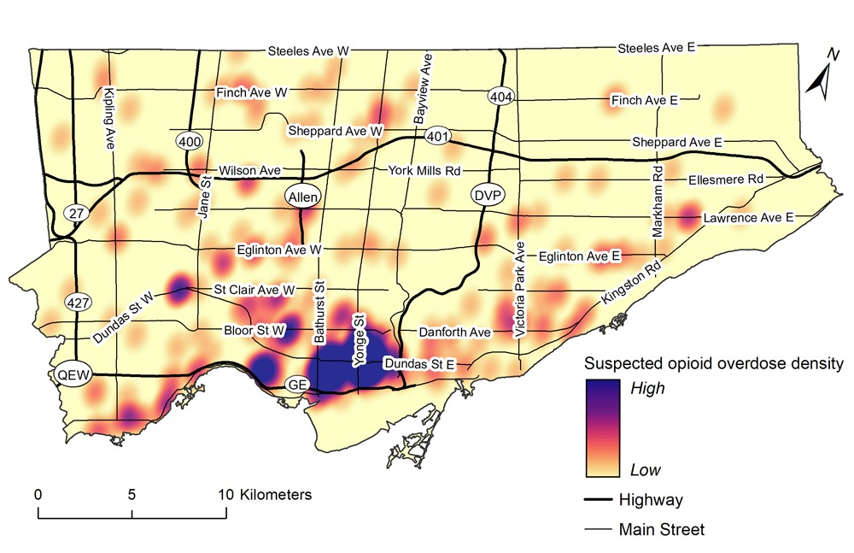
Background – “The Opioid Crisis”

Slide 6
Background – Other Pressures
Environment?
Clinical Practice Guidelines?
Media and public perception?
College of Physicians and Surgeons of Ontario?
Health Quality Ontario?

Slide 7
Background – Pharmacist Role
Referral-based
  “Low-barrier” – phone /email / face-to-face / “text” message
  “Directional” – physician (or other health discipline) → pharmacist
  “Generalized” – breadth of episodic care and chronic disease management

Slide 8
Research Question
Can pharmacists at an academic family health team lead opioid stewardship interventions to reduce co-prescribing of chronic opioids and a benzodiazepine among outpatients?

Slide 9
Project Objective
The objective of this project was to implement proactive, pharmacist-led reviews of patients with chronic non-cancer pain co-prescribed opioid(s) and benzodiazepine(s)

Slide 10
Measures
Outcome Measure | Process Measure(s) | Balancing Measure(s)
Mean daily opioid dose (milligrams morphine equivalent, MME) Mean daily benzodiazepine dose (milligrams diazepam equivalent, MDE) | Percent of co-prescribed patients assessed by a pharmacist Percent of co-prescribed patients offered an opioid taper Percent of co-prescribed patients with an active opioid taper | Substance use Pain Prescriber-patient relationship

Slide 11
PDSA Cycles

Slide 12
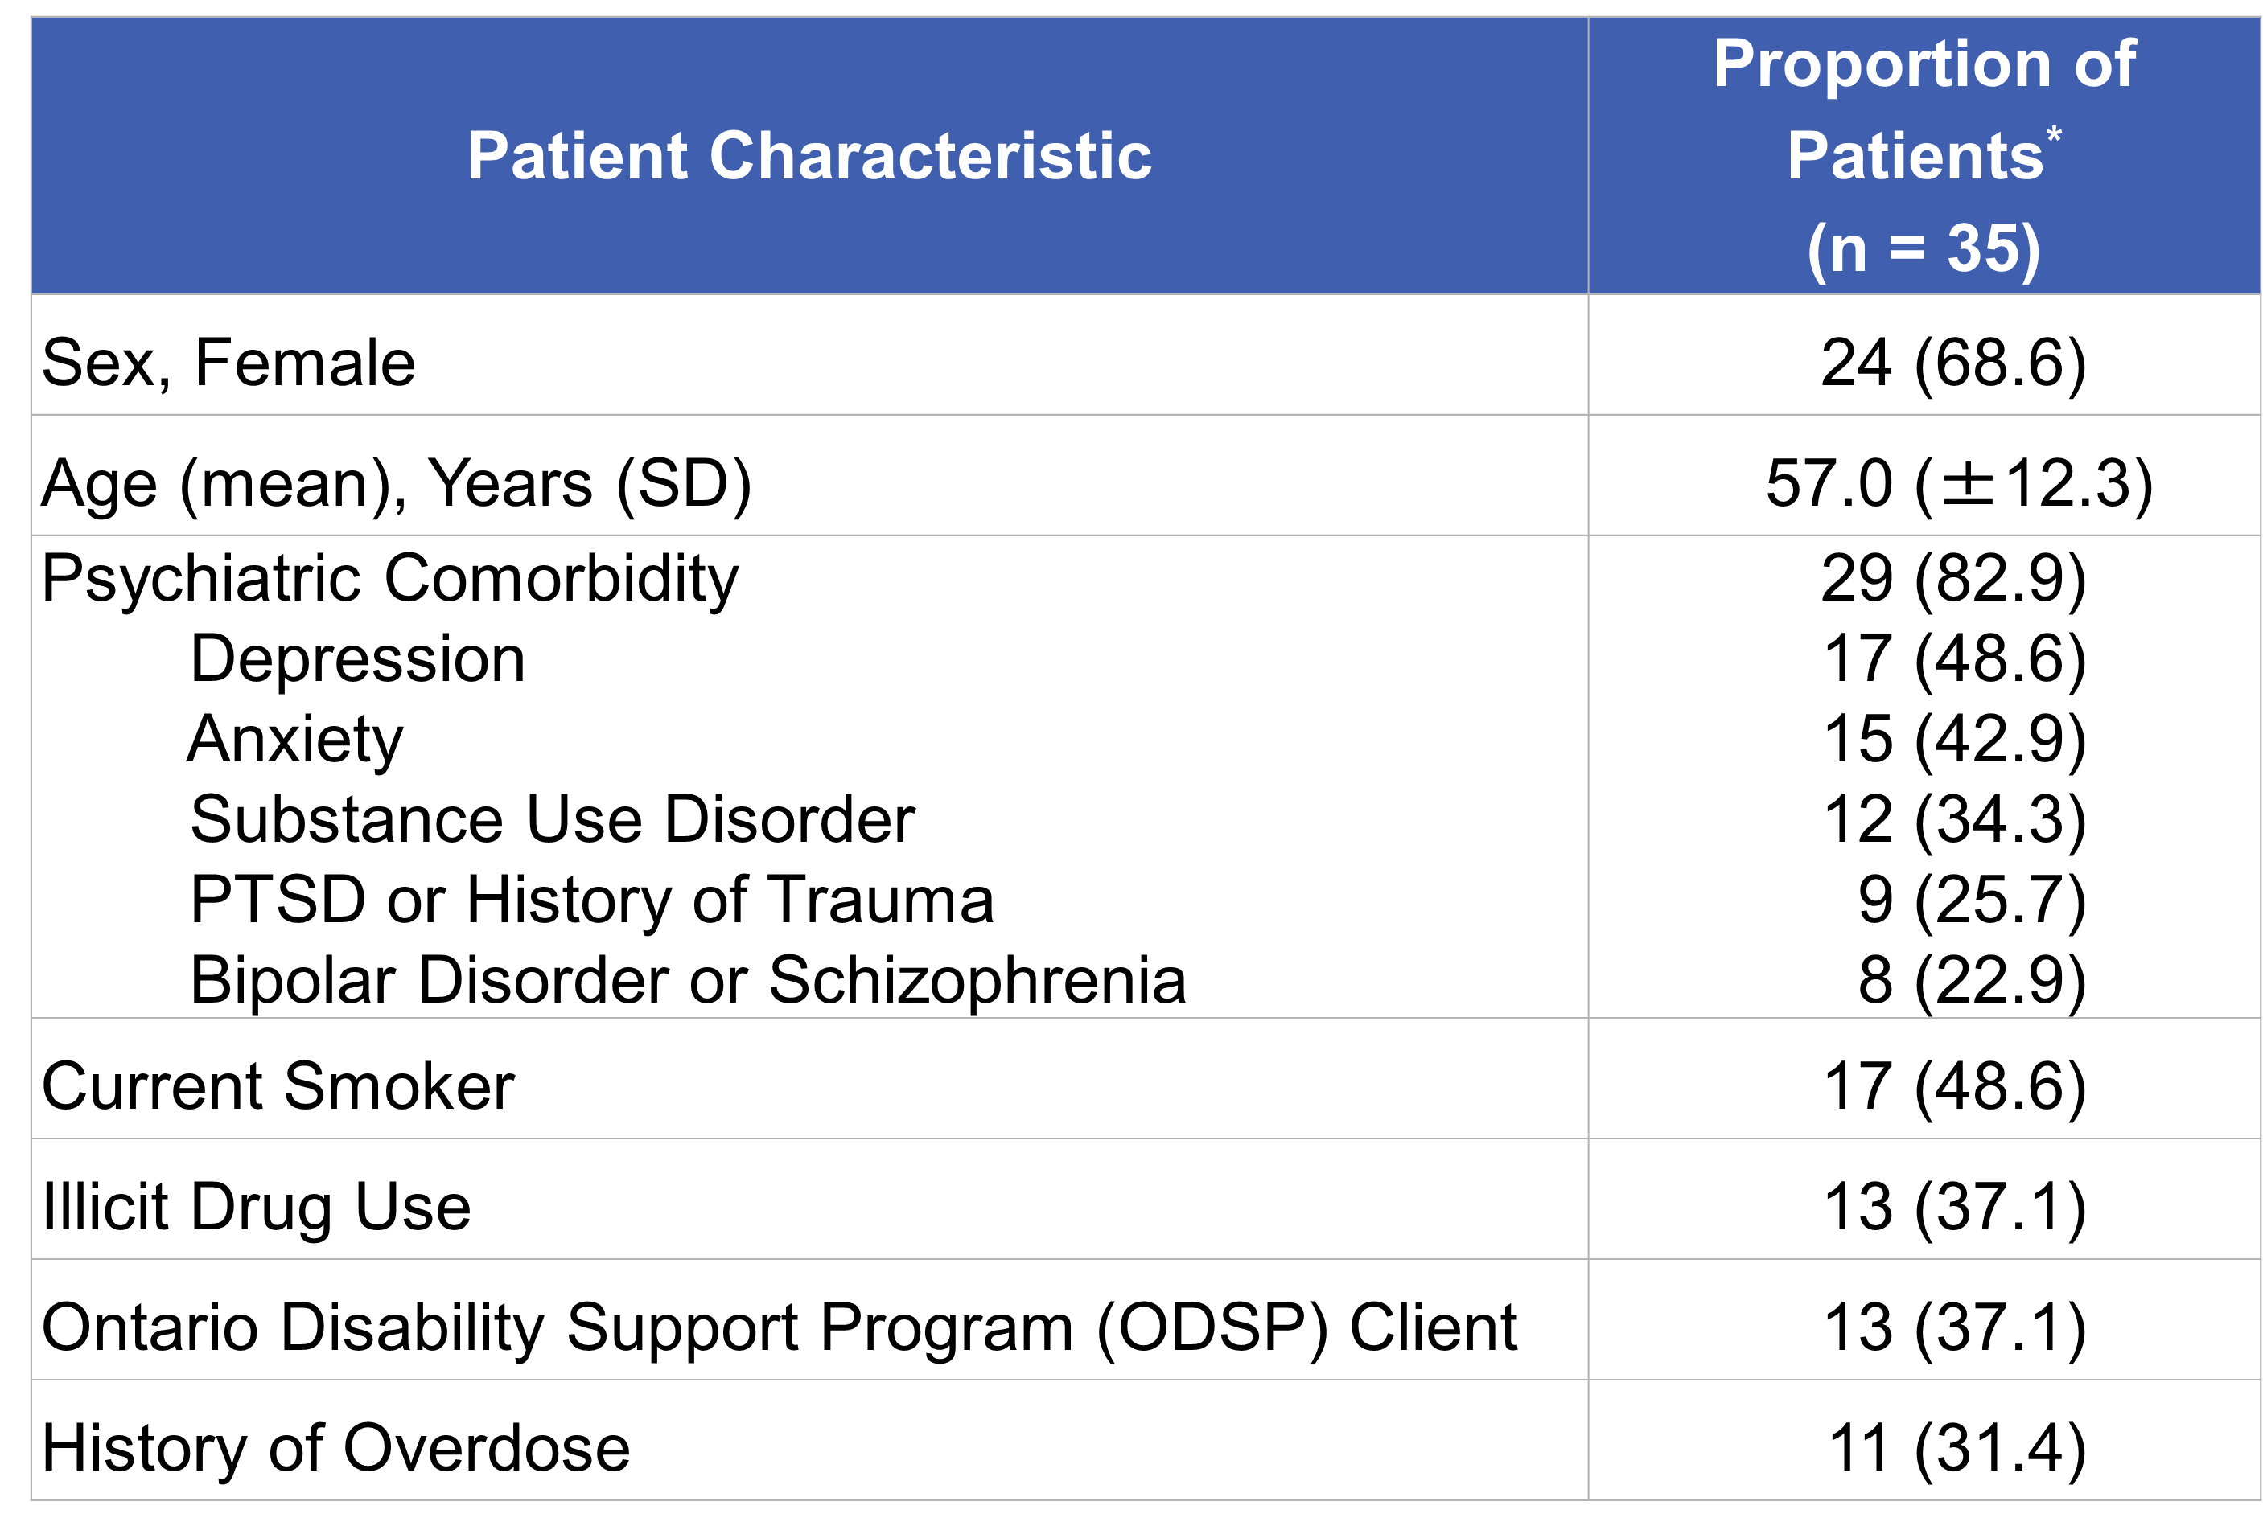
Results & Highlights

Slide 13
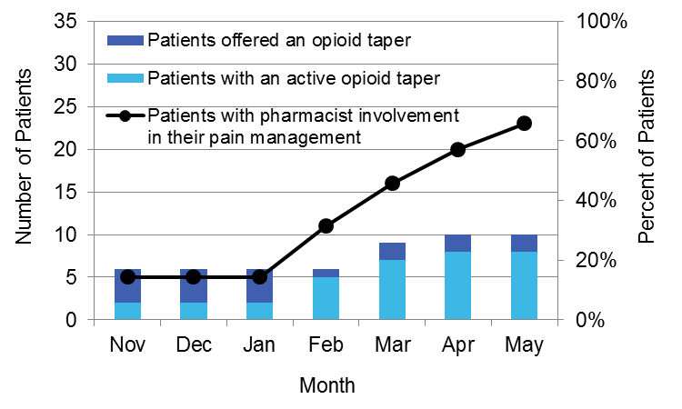
Results & Highlights

Slide 14
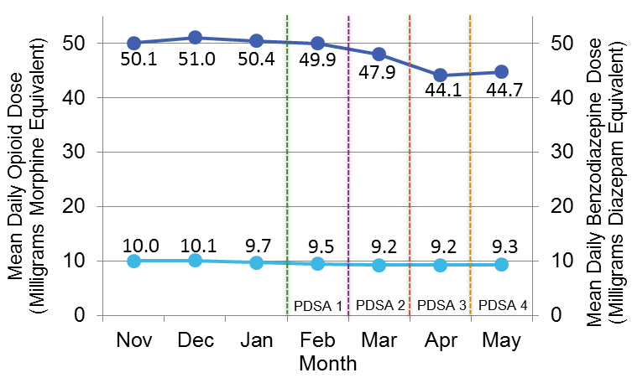
Results & Highlights

Slide 15
Results & Highlights
No noted increase
  Overdose, death, or hospitalization
  Breakdown in physician-patient relationship
  Illicit drug use
  Smoking rates
  Pain scores

Slide 16
Results & Highlights
Providers
  Open to alternative engagement approach (i.e. proactive)
  Value efficiency (i.e. review all patients at one time)
  Preference for face-to-face (versus electronic)
Patients
  Pill burden
  Hyperalgesia
  Overdose risk

Slide 17
Organizational Enablers
Hospital Pharmacy Department
  Pharmacy Practice Resident research project
Family Health Team
  Quality Steering Committee
  Opioid Working Group

Slide 18
Sustainability/ Next Steps
Ongoing review at initial clinic sites?
Expand to other clinics?
Other populations?
Other proactive, pharmacist-led interventions?

Slide 19
Contact
Name: Jon Hunchuck
Title: Clinical Pharmacy Practitioner
Organization: St. Michael’s Hospital Academic Family Health Team
Phone: 416-864-6060 x76810
Email: jonathan.hunchuck@unityhealth.to

Slide 20


Improving Participant Retention in the BounceBack Ontario Program
A. Hogue
Canadian Mental Health Association – York and South Simcoe
January 14, 2020
E-QIP Logo

Slide 21
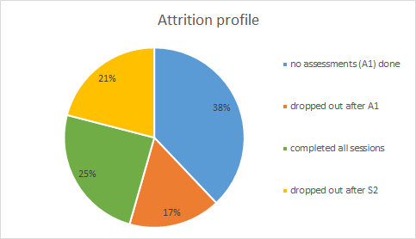
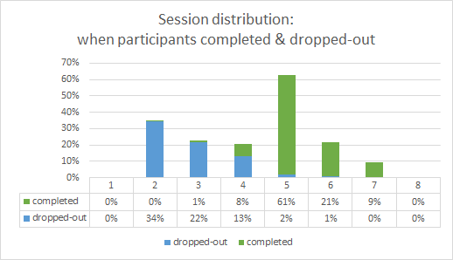
Our Story
The BounceBack (Ontario) program is a phone-coached, free self-help program for Ontarians (age 15 and above) experiencing mild to moderate levels of depression and anxiety.
Pre-and-post program depression and anxiety scores suggest that participants who complete the Program report up to 40% reduction in low mood and anxiety symptoms, yet, at least 34% of participants who begin the program become unreachable or withdraw from the program (drop-out) before they complete the second coaching session (Session 2).
Notes:
-

Slide 22
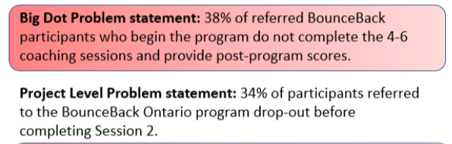
E-QIP: BounceBack Ontario – Focus on Participant Retention
Problem Statement

Slide 23
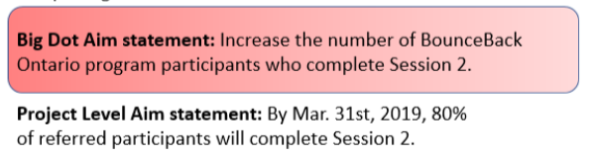
E-QIP: BounceBack Ontario – Focus on Participant Retention
Aim Statement

Slide 24



E-QIP: BounceBack Ontario – Focus on Participant Retention
Data Collection
Data collection through:
  Fishbone Diagram (staff voice)
  Baseline Data
  Experience Survey (participant & referral source voice)
  5 Whys
Notes:
ASHLEY
What deterred you from finishing the BounceBack program? (bracketed descriptions are examples)
Not the right timing (too busy, and had many other commitments)
The Coaching (style, cultural and gender differences)
The sessions (having to talk over the phone, the structure, the duration)
The materials (too much work, workbooks wasn’t applicable, difficult to read)
The accessibility (scheduling was hard, hours of operation, language barriers)
Other: ________________________________________________
Why was it helpful?
Keeps everyone focused on the same problem
Everyone gets a chance to contribute, see that their ideas are captured and won’t be lost;
Expands brainstorming to include different types of causes;
Allows for thorough exploration of a problem;
Can guide teams to a change idea that will have an impact
One of the simplest root cause analysis tools, “the 5 whys” technique uses a question-asking method to explore the cause-and-effect relationship underlying the problem.
•schedule a meeting, informing the participants of the topic to be discussed.
•keep asking “why” until a meaningful conclusion is reached. Generally, a minimum of five questions should be asked, although additional questions are sometimes required if the real cause is yet to be identified, rather than simply settling for a partial conclusion

Slide 25

E-QIP: BounceBack ON – Focus on Participant Retention
Diagnostic journey
Change Ideas
Impact-Effort Chart
Pareto Chart
Driver Diagram
PDSA Cycle!
Notes:
We conducted Change Ideas Generating Exercises with the frontline program staff, and collected a large number of Change Ideas to theme and evaluate Impact of and Effort involved through the Impact-Effort Chart and a Pareto Chart (Thank you QI Coach Laura!)
We then utilized the Driver Diagram to lay out the logistic linking our chosen Change Idea back to our Aim.
Given that we were all frontline staff, we all were excited to generate idea after idea, very motivated to change our service processes for a smoother and more efficient procedure. It was easy to expect some major change ideas to come out of these exercises, but the Impact-Effort Chart really helped us see that the highest impact and lowest effort change idea wasn't a major renovation.

Slide 26
E-QIP: BounceBack ON – Focus on Participant Retention
Change Ideas
The Change Idea
Chunked out the First Phone Assessment Session (40-55 minutes), into three chunks:
an Information Session (telephone)
an Information Package (email/mailed) and,
a shorter, focused phone Assessment (telephone)
Improvement would be made if:
The # of participants dropping out of subsequent sessions has decreased
Able to schedule additional information phone sessions (indicating time efficiency)
Staff satisfaction is higher
Risky assumption: it reduces length of the assessment by separating the current practice into PreA1 and A1
Available evidence: idea was derived from the responses of participants who indicated that they are seeking counselling/face to face

Slide 27
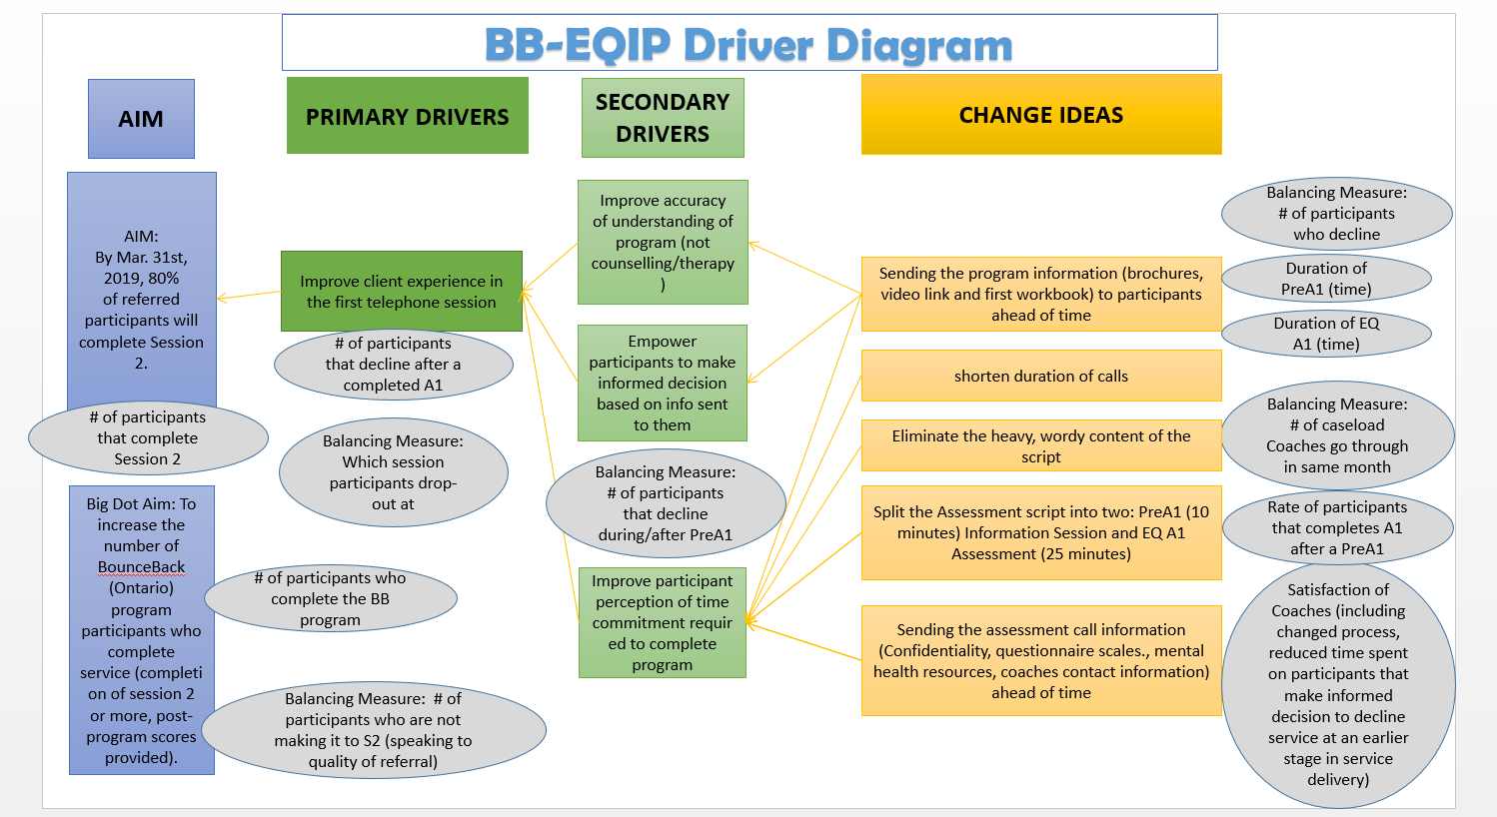

Slide 28
E-QIP: BounceBack ON – Focus on Participant Retention
Measures
Outcome Measure | Process Measure(s) | Balancing Measure(s)
Number of enrolled participants who complete a session 2 | Number of participants who drop-out (withdraw/unreachable) from BB before held assessment Number of participants who drop-out (withdraw/unreachable) from BB after held assessment | Duration of sessions (minutes) Number of participants who enroll in BB, relative to total number of referrals. Coach satisfaction

Slide 29
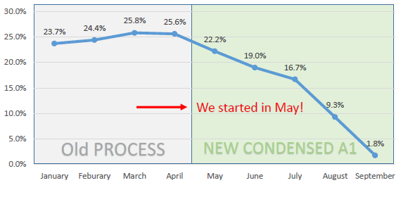
E-QIP: BounceBack ON – Focus on Participant Retention
Run Chart – Percentage of Participants Who Withdrew After Assessment
Enrollments |  |  |  | 928 | 887 | 788 | 786 | 713 | 398
# withdrew |  |  |  | 238 | 197 | 150 | 131 | 66 | 7

Slide 30
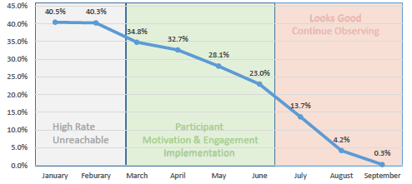
E-QIP: BounceBack ON – Focus on Participant Retention
Run Chart – Percentage of Participants Who Were Unreachable After Assessment
# Enrollments |  |  |  | 928 | 887 | 788 | 786 | 713 | 398
# unreachable |  |  |  | 303 | 249 | 181 | 108 | 30 | 1

Slide 31
E-QIP: BounceBack ON – Focus on Participant Retention
Results and Highlights
Participants make more informed decisions
More motivated and engaged participants are enrolled in the program
Coaches have higher job satisfaction
Primary care providers have outcome of referral faster for less engaged participants
Notes:
Increase in the number of PTs who withdraw from BB after Information Session (before held assessment)
Participants making informed decisions before using coach time
Decrease in the number of PTs who withdraw from BB after a held assessment
More engaged participants are enrolled in the program
Coaches have higher job satisfaction with less chasing participants
Primary care providers have outcome of referral faster for less engaged participants

Slide 32
BounceBack Ontario – Focus on Participant Retention
Organization
Support from leadership and corporate QI committee
Ongoing reporting updates to leadership
Integration of QI methodology with strategic change tools
Organizational culture that supports testing new ideas
Ability to capture and analyze data
Notes:
Support from leadership (Director, CEO and Project Leads) and Corporate QI Committee
Ongoing reporting updates to leadership
Integration of QI tools with Strategic Change tools for successful implementation of change idea
Culture that supports testing new ideas and acknowledges not all ideas will work
Ability to capture and analyze data to support implementation of change idea

Slide 33
BounceBack Ontario – Focus on Participant Retention
Sustainability
Established a BounceBack/Ontario Structured Psychotherapy QI Committee at CMHA-York and South Simcoe
Continue to foster a culture on the team to bring forward new problems and a structure to work towards improvement
Notes:
Established a BounceBack/Ontario Structured Psychotherapy QI Committee at CMHA-York and South Simcoe
Leveraged training and tools to test new projects
Continue to foster a culture on the team to bring forward new problems and can provide a structure and tools for how to identify the root cause, change ideas and strategic implementation of change

Slide 34
BounceBack Ontario – Focus on Participant Retention
Contact
Ashley Hogue
Senior Director of Provincial Initiatives (Ontario Structured Psychotherapy)
CMHA York and South Simcoe
Canadian Mental Health Association
8271 Keele St., Unit 2, Concord, ON L4K 1Z1
T 289-879-3446
E ahogue@cmha-yr.on.ca

Slide 35
Questions

Slide 36
QI Resources

Slide 37

Tweet to us!
Follow us!
@afhto
Tag us using #EQIPON

Slide 38
Quality Improvement in Primary Care (QI in PC) Community of Practice (CoP)
80+ members working in QI
  QIDSS, Quality Improvement & Information Management Specialists, QIDSS-like, RDDS, QI and Data Coaches
Support from AFHTO KTE Specialist & QI in Primary Care Council
  5 appointed QIDSS and QIDSS-like on the QI in PC council
Monthly virtual CoP calls
  Updates/presentations from quality workers in the field
  Collective projects/priorities
  Presentations from external stakeholders
  Upcoming events
Email listerv to connect with peers across Ontario – qiprimarymembers@emaildodo.com
Notes:
The CoP consists of 80+ members including QIDSS, QIIMS, QIDSS like and other quality specialists from AHC and CMHA/AMHO, they receive support from AFHTO and Council.
The CoP meets monthly via virtual meetings. At these meetings teams have the opportunity to present updates or initiatives they are working on within their teams and discuss collective projects and priorities. Often there are presentations from external stakeholders and organizations (i.e. HQO, digital health organizations and other healthcare providers/organizations).
The group communicates through email listerv which allows individuals ask their peers questions, share resources & tools through one email address

Slide 39

E-QIP’s CoP
Notes:
To join, sign up for “Quorum” at https://quorum.hqontario.ca/

Slide 40

E-QIP Newsletter
Join our mailing list to stay informed of future webinars and training events:
http://eepurl.com/b1A5EX
Notes:
Please join out mailing list (link in the description) to stay up to date on E-QIP and learning opportunities for you!

Slide 41

E-QIP’s Webinar Series
Quick QI Webinar Series
Trusting the QI Process
Driver Diagram
The Role of data in PDSA Cycles
Prioritizing QI in CMH&A
Data Culture and Assessment
QI Assessment
Sustainability Assessment
Experience-Based Co-Design
Client and Family member Engagement
Enhancing “joy in work”
QI Mythbusting
Primer on Governance and Leadership
QI in Community Mental Health and Addiction
Cohort 2 Report back presentations
Cohort 3 and Networks Report back presentations
OHT Webinar
Sustaining your gains & preventing short-lived improvements
Sustainability and Spread

Slide 42
E-QIP’s Quick QI Webinars
E-QIP’s Quick QI webinar series now available online!
For those interested in understanding or refreshing their knowledge on the Model for Improvement, this webinar series is for you. E-QIP coaches have developed this series of 9 webinars which are twenty to thirty minutes each. These webinars are based on our coach’s first-hand experience and use a case study on reducing wait times to case management programs to demonstrate how to use QI tools. The webinar series can be viewed here and supporting slide decks and resources for each webinar can be found here.

Slide 43
Debbie Bang
Director of Quality Improvement
Addictions and Mental Health Ontario
debbie.bang@amho.ca
416.490.8900 ext. 1623
Ashley Koster
E-QIP Program Manager
CMHA Ontario
akoster@ontario.cmha.ca
1.800.875.6213 ext. 4137
Sandeep Gill
Clinical Knowledge Translation and Exchange Specialist
Association of Family Health Teams of Ontario (AFHTO)
sandeep.gill@afhto.ca
647.234.8605 ext. 202
Amy Patel
Program Manager
Addictions and Mental Health Ontario
amy.patel@amho.ca
416.490.8900 ext. 1627
Laura Daly-Trottier
Quality Improvement Coach
CMHA Ontario
ldaly-trottier@ontario.cmha.ca
705.499.0850
E-QIP Accomplishments and Lessons Learned

