Slide 1

PRIMARY CARE PROVIDERS:
OHT Information
Session

Slide 2

Tonight’s Agenda:
  Overview of Ontario Health Teams
  Current state of OHT process across Ontario
  Role of Primary Care in the development of an OHT
  Digital Health Playbook
  Regional OHT
  Opportunities and Risks for Primary Care providers
  Q&A
  Summary and Actions

Slide 3

What’s Top of Mind for YOU?
What are you hoping to get out of this session ?

Slide 4
Ontario Health Teams:
The who, what, why behind OHTs…
Context:
  PC gov focus on reducing wait time + ending hallway medicine
  Budget deficit driving reduction in gov expenditure
  Need for more integrated care
  Bill 74: The People’s Healthcare Act
  Introduced Feb 26, 2019 and passed April 19, 2019
  Has three parts:
    Connecting Care Act, 2019
    Amendment to MOHLTC Act
    Amendments/repeals to over 29
    other pieces of legislation
  Creation of central agency
  “Ontario Health”
Introduces “Ontario Health Teams”
(OHTs)
Notes:
New Government’s Mandate to Address Ontario’s Health System Capacity Challenges
1.Patients and families are having difficulty navigating the health care system and are waiting too long for care.
2.The health care system is facing capacity pressures and is not appropriately resourced for the projected increase in complex care needs and capacity pressures.
3.Effective coordination is needed at both the system level, and at the point-of-care.
Amendments to Ministry of Health and Long-Term Care Act (Indigenous health council + French language health services advisory council)
Amendments/repeals to over 29 other pieces of legislation
Changes generally to recognize Ontario Health and remove LHIN
Some substantive amendments

Slide 5
Connecting Care Act, 2019:
On June 6, 2019, the Connecting Care Act (CCA) was proclaimed into force…
Ontario Health:
  Established Ontario Health as Province-wide
  Central Agency (subsumes existing agencies)
  Crown agency with Board of Directors of up to 15 directors appointed by Lieutenant Governor in Council
    Initial Board of Directors appointed on March 8th
  Minister to provide funding to Ontario Health pursuant to an Accountability Agreement
  Ontario Health to provide funding pursuant to a Service Accountability Agreement to Ontario Health Teams
Ontario Health Teams:
14 LHINs
HQO
CCO
Trillium Gift of Life
eHealth Ontario
HealthForce Ontario Marketing & Recruitment Agency
Health Shared Services Office
New model of care where a group of providers (e.g. hospitals, home care, primary care, mental health and others) voluntarily come together and self-organize to deliver a coordinated continuum of care to a defined population or patient segment. Eventually to be funded through integrated funding envelope.
Notes:
Although the new entity has been created, Ontario Health will not be fully operational until the transfer and consolidation of existing agencies is complete
OH – initial slate of BOD announced (12); susan Fitzpatrick interim CEO. possess a wide range of specialized skills, from health care to business operations, from logistics to public service delivery, from community engagement to volunteerism.

Slide 6
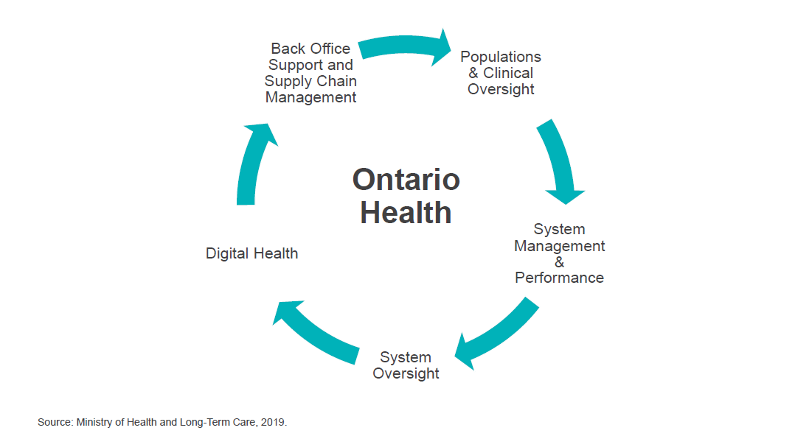
Ontario Health

Slide 7

Ontario Health Teams: OHTs
Through this model, groups of health care providers will work together as a team to deliver a full and coordinated continuum of care for patients, even if they’re not in the same organization or physical location.
Currently voluntary and provider driven but stated goal is “for all health service providers to eventually become Ontario Health Teams” (aka NOT a pilot project)
Population-based
Intended to be 30-50 across the Province over time, selected through Self-Assessment submission and Application process by invitation
OHT
High use of Digital Tools: Enable high degree of clinical integration supported digitally with common goals to support population health outcomes, based on quadruple aim (quality, experience, efficiency, providers)
24/7 Navigation Support. Patient is at the centre with virtual care and access to information
Seamless Transitions: fully integrate care across the continuum of care to deliver more coordinated, better, faster care at a lower cost
GOALS
Notes:
Outcome based blended funding model
^{Risk and gain sharing}
^{Shared electronic records}
^{Virtual access}
^{ACO’s in the US:}
^{-capitated pop}
^{Continuum of care}
^{-risk adjusted paying}
^{Risk/gain sharing}
^{Integrated information systems}
^{Start up 1-2M}

Slide 8




MOHLTC
Ontario Health
Ontario Health Team (OHT)
Governance Structure
Primary Care
FHTs
FHOs/FHGs/FHNs
CHCs
Solo GPs
Health Service Providers
Hospitals
Mental health or addictions services
Home care or community services
Long term Care home services
Palliative care services
Terms + Conditions for partnership incl:
Conflict + performance mgt
Info. mgt
Risk + gain sharing
Performance plan
Notes:
Under the CCA, the Minister may designate a person or entity or a group of persons or entities as an OHT, provided that they have the ability to deliver in an integrated and coordinated manner at least three of the following types of services:
hospital services,
primary care services,
mental health or addictions services,
home care or community services,
long-term care home services,
palliative care services, and
any other prescribed health care service or non-health service that supports the provision of health care services.

Slide 9

OHT Governance
Spectrum…
Shared Management
Single OHT Corporate Entity
Operational Coordination
Joint Board Governance
Ontario Health Teams to determine how best to
self-organize
  Each participating sector may maintain independent legal entities with independent management and independent Board of Directors
Governance arrangements may evolve as OHTs mature and funding and accountability relationships shift
No funding changes in near future; at maturity: one integrated funding envelope.
Most OHTs
are here
Notes:
Each participating sector may maintain independent legal entities with independent management and independent Board of Directors
Integration through Contract and Committees
Each OHT to determine:
Classes of members?
Decision making?
Scope of authority?
Different models and implications depending on flow of funding and accountability

Slide 10
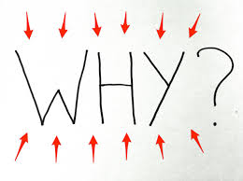
OHTs:
Physicians and patients want integration
Will allow doctors to spend time giving care (and make them more efficient)
Primary Care is the key!
Brings ‘bureaucracy’ to the level of patient care
As a team, OHTs will work to achieve common goals related to improved health outcomes, patient and provider experience, and value.
  Offer patients 24/7 access to coordination of care and system navigation services and work to ensure patients experience seamless transitions throughout their care journey
  Operate within a single, clear accountability framework
  Improve access to secure digital tools, including online health records and virtual care options for patients – a 21st century approach to health care
  Be funded through an integrated funding envelop
  Reinvest into front line care
  Central point for Performance, Measurement + Quality Improvement
*OHTs are NOT a replacement for FHTs or other existing primary care models
* OHTs are NOT a new payment model for physicians; PSA remains
*OHTs will include component of risk/gain sharing (unclear what this means for MDs)
Notes:
Risk sharing - Each partner shares financial gains from efficiencies.
Aligns incentives across different providers and sectors.
For OHTs, all savings must be redirected into front line care.
The criteria for an OHT are not tied to any particular type of practice model.

Slide 11
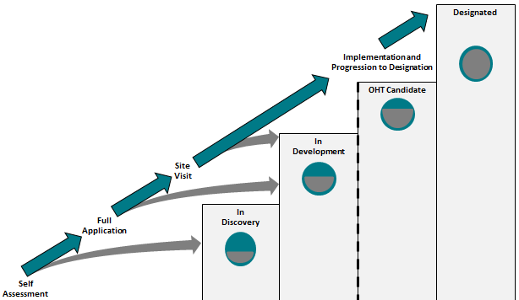
OHTs
What’s the process to become an OHT…?
Self-Assessing Readiness: Interested groups of providers and organizations submit Self-Assessment of readiness (Minimum of 3 care domains/services (Primary Care, Acute Care, and Community Care)
Validating Provider Readiness: Based on Self-Assessments, groups of providers identified as:
      In Discovery
      In Development (Those in development will be invited to submit an application to become an OHT candidate)
Becoming an Ontario Health Team Candidate: Based on full application process, those identified as meeting readiness criteria may be selected to begin implementation of the model
Becoming a Designated Ontario Health Team: Once ready to receive an integrated funding envelope and operate under a single accountability agreement, designated as an Ontario Health Team
Notes:
*Groups may be asked to collaborate with additional providers and resubmit a joint Self-Assessment
* Government will provide matchmaking and support to advance readiness

Slide 12
OHTs: Current State
First call for Ontario Health Team Self-Assessments closed on May 15th; over 150 submissions
MOH reviewed self-assessments and identified 31 groups that will proceed to full application, 41 groups that are designated as “in development” and the rest remain “in discovery”. See the MOH list and the OMA interactive map.
Submission date for full applications is October 2019. The first OHT Candidates will be announced in Fall 2019.
Submission date for next round of self-assessments is December 2019. Assessment process will be repeated until full Provincial coverage of OHTs is achieved.
Different models emerging including hospital-led as well as primary care and community-led
Varying levels of engagement with private sector health – medical technology, digital health, private home care are major players as well
Each OHT is at a different stage of building relationships and trust
Partners have varying influence and dominance within the OHT

Slide 13
Role of Primary Care in OHTs
Family doctors are the core of our health care system … the only true INTEGRATORS … integration being a goal of OHTs. We interact with every sector on behalf of our patients on a regular basis. We see and understand what is going on in health care - in a way administrators and government cannot.
These longitudinal relationships that exist between patients and their primary care providers are the foundation of our health care system.
Because of this, any radical system change being promoted – like OHTs – needs to be physician-led, anchored in primary care … and AFHTO/SGFP/OCFP also advocate that it be voluntary.
Family doctors need to be leaders!!
  involved in the formative stages of OHT development
  Involved in governance and system design
  leading at all levels … with patients, with other health care providers, with administrators, & with the government
Notes:
Lessons from other jurisdictions suggest that strong physician engagement and leadership –particularly among primary care providers –is key to successful implementation of integrated, better connected care.
Successful Ontario Health Teams can be built on existing physician remuneration models.
Changes to physician compensation are subject to negotiation with the Ontario Medical Association under the binding arbitration

Slide 14
ISSUES & UNKNOWNS WITH OHTs
More unpaid, volunteer work More administrative work - contracts, governance, data collection, QI … Risk of being responsible for 24/7 Care Coordination and System Navigation Risk of loss of practice autonomy - no longer specifically excluded in legislation as Health Service Providers Risk of losing current payment models … but ? gain benefits/pensions Risk of having to roster all patients in the region, despite provider shortages | Hidden Costs - IT funding? risk of clinic staff wanting hospital wages and benefits? One funding envelope by OHT maturity … will “efficiencies” or cuts come from primary care if hospital over-budget? Do we have enough interested & available physician leaders? Burnout – do physicians have the energy to get involved and lead? will this actually help energize us? Patients – will government tell them what to do? Lots of unknowns!!!
Notes:
HSPs – subject to oversight by the government re. accountabilities, investigations, standard setting, and mandatory integration

Slide 15
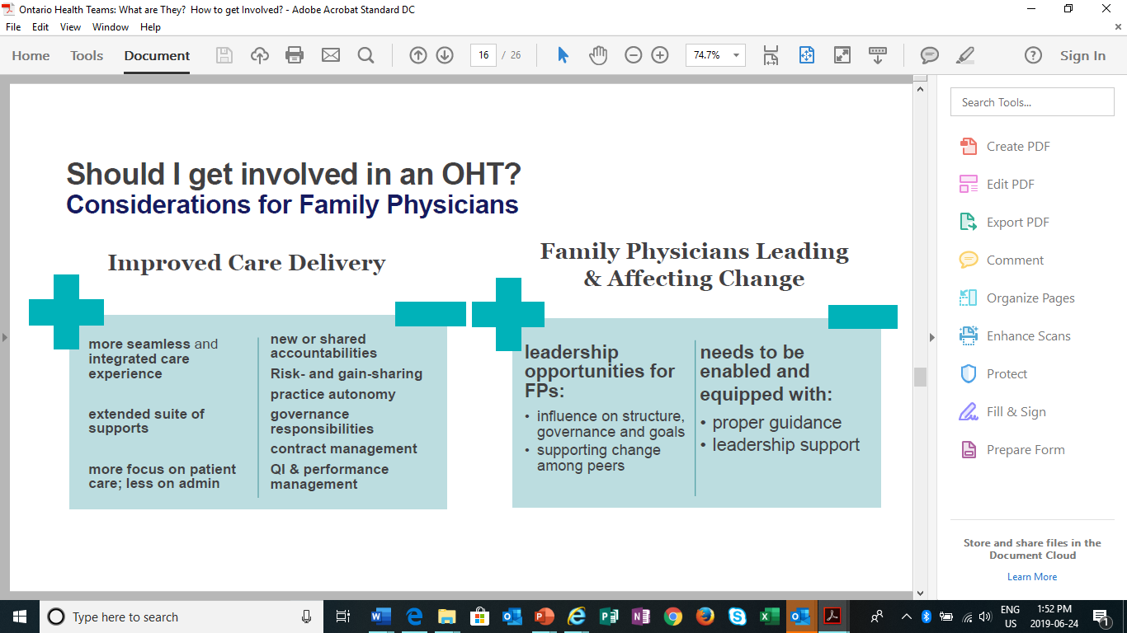

Slide 16
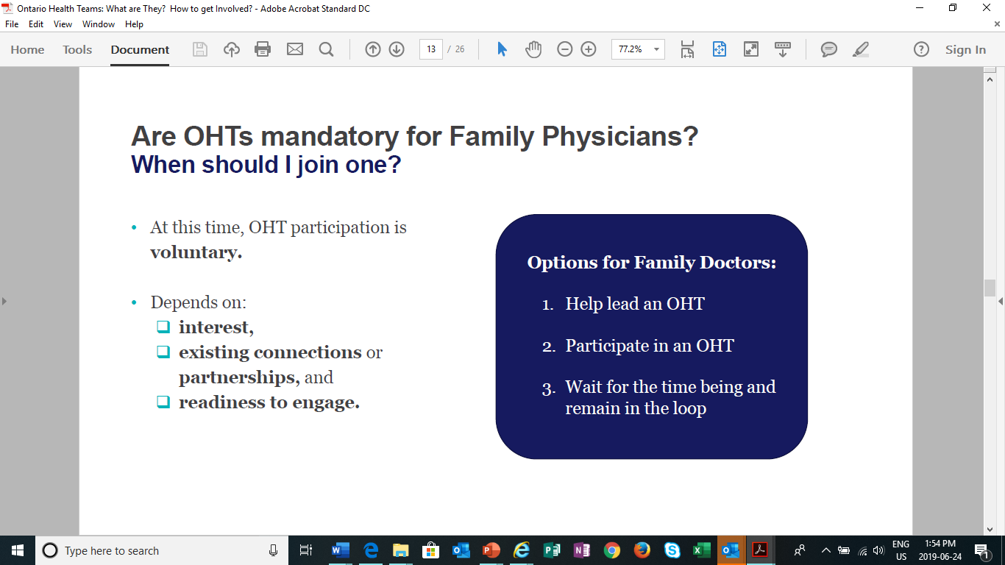

Slide 17

OHTs Connecting Care Digitally
OHT
Primary Care Provider Session

Slide 18
Agenda
How the adoption and use of digital health solutions can help OHTs
Overview of the Digital Health Playbook
How OntarioMD can help OHTs

Slide 19
How Digital Tools Can Help
Ontario’s health care system is being transformed to support seamless, integrated care.
Digital health is at the core of a more connected and integrated health care system.
Through digitally-enabled Ontario Health Teams (OHTs), care providers will have access to technologies, tools and information to better meet the needs of their patient populations, and patients will be empowered with choice in how they access their health care.

Slide 20
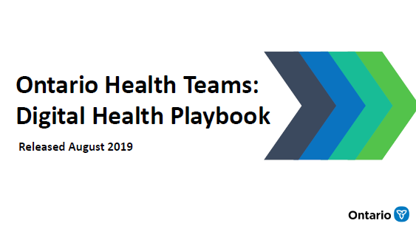
The Digital Health Playbook has been created to support prospective OHTs in the development of their digital health strategy.

Slide 21
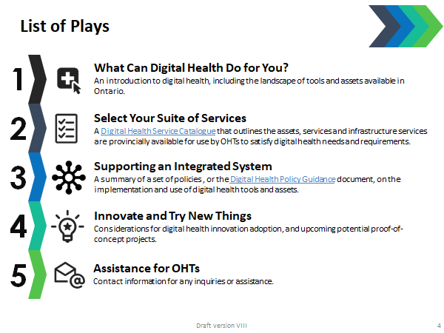
Overview of the Digital Health Playbook
The Playbook is made up of 5 Simple Plays that illustrate:
  Foundational digital health concepts;
  Overview of Ontario’s digital health landscape and options available;
  Digital health requirements for OHTs;
  Digital health priorities and innovations;
  Supports available for OHT applicants and early adopters; and
  Contact information for questions and inquiries.
Source: Ministry of Health Digital Health Playbook

Slide 22

Lists assets and digital health tools currently available in the province and provides information on who OHTs can contact for access
Also outlines which of the assets and tools are required or could be used

Slide 23

7 policies in total – 4 general and 3 system specific
  Digital health information exchange
  Digital health investment and value for money
  Digital health access and privacy and security
  Digital health reporting and performance
  Clinical systems draft policy direction
  Patient facing digital health draft policy direction
  eServices solutions draft policy direction

Slide 24




















OntarioMD & Digital Health Services
OntarioMD Initiatives:
Our Partners:
Partnered Initiatives:
eHealth Ontario
Health Quality Ontario
Health Shared Services Ontario

Slide 25


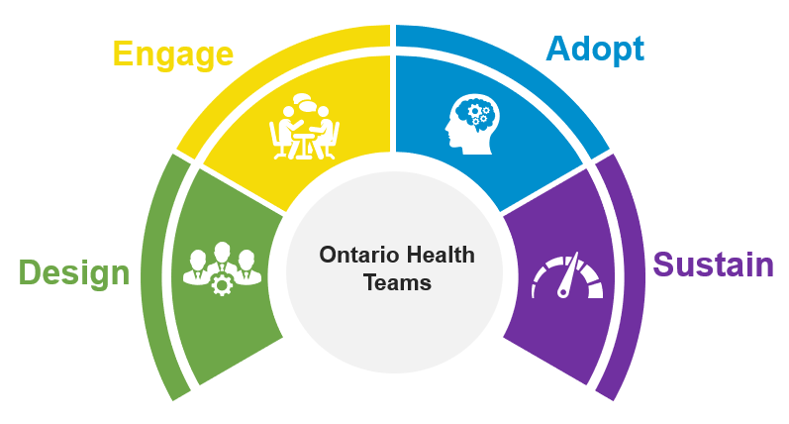

Digital Health Partner Consortium
OntarioMD, with Digital Health Partners (DHPs), has developed a coordinated change management model to support digital health service adoption activities in your Digital Plan.
For physicians it is critical that these activities are coordinated and streamlined to support adoption, use and reduce administrative burden.
eHealth Ontario
Health Shared Services Ontario

Slide 26
CM&A Benefits
Digital Health Partners
Ontario Health Teams
Clinicians
Provide OHTs with ability to leapfrog and capitalize on quick delivery and change management support for digital health services
Prioritize access to the contents of the DHSC
Reduce the complexity of digital service adoption with a streamlined approach
Enable client-centric engagement to reduce barriers to adoption
Enhanced patient and clinician experience
Provide education and awareness about the digital health assets
Support adoption of digital health products and services
Provide on site advisory, training and support services
Support seamless integration of new digital health assets within the clinic
26

Slide 27







Thank You!
Questions and Discussion
OntarioMD Support
support@ontariomd.com / 416-623-1248 / Toll-free: 1-866-774-8668
ontariomd.ca
ontariomd
ontarioemrs
ontariomd
ontariomd
ontariomd.blog

Slide 28
Regional OHT (discussion)

Slide 29
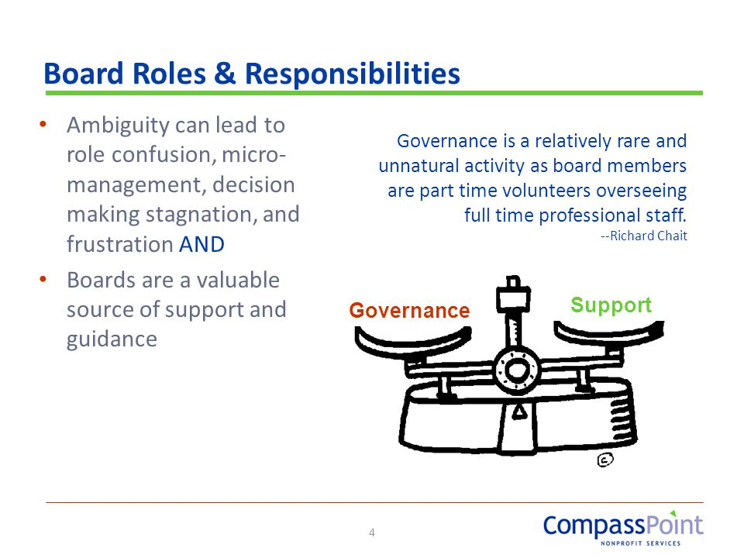
Opportunities & Risks
Risk
Opportunity

Slide 30
Considering joining an OHT?
Questions to think about…
Do I have pre-existing relationships with partners at the OHT table?
Am I on the same page as the other partners? Do we share a common vision?
Are roles and responsibilities of all partners clear? What will each contribute?
  Do these roles and responsibilities still need to be defined? If so, will I have an opportunity to participate in scoping those definitions?
Is there a governance model? Are family physicians at the table?
  Is there a mechanism for ensuring meaningful family physician engagement?
How will FPs participate in ongoing implementation?
  How will I be part of clinical decision-making in the OHT, not just in the set up, but as it rolls out?
If I choose not to voluntarily participate right how, does that mean my patients may not be able to access OHT resources?
What does success look like for each partner? What are the measures? Outcomes?
What is the approach for change management – how will I be supported to embed change?
Related to the above, will my time be compensated for planning?
Notes:
We have put a list of questions that may help you get the information you need so that you can make decisions that will work best for you, your practice and your patients.

Slide 31
How do I learn More…
Speak to other family physician leaders in your community about some of the activity already underway
Email:
  The OCFP at ocfp@ocfp.on.ca
  The OMA at OMA_OHT@oma.org
  The Section on General and Family Practice, OMA, at OHT@sgfp.ca
  The Association of Family Health Teams of Ontario at info@afhto.ca (if part of a FHT or want to connect with a FHT)

Slide 32
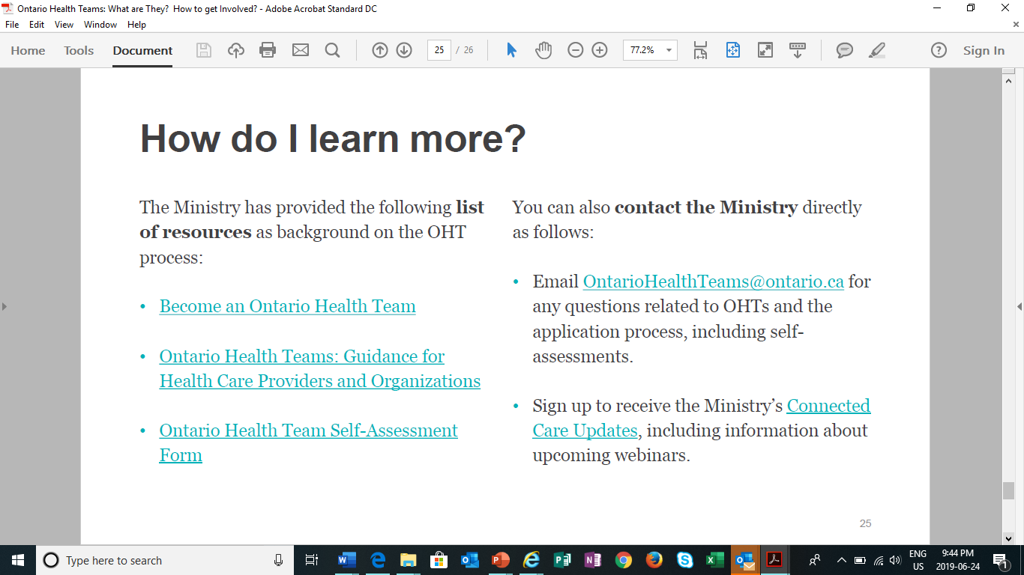

Slide 33

Next Steps?

