Slide 1
Huron Perth & Area Ontario Health Team
Presented by Matt Hoy & Monique Hancock

Slide 2
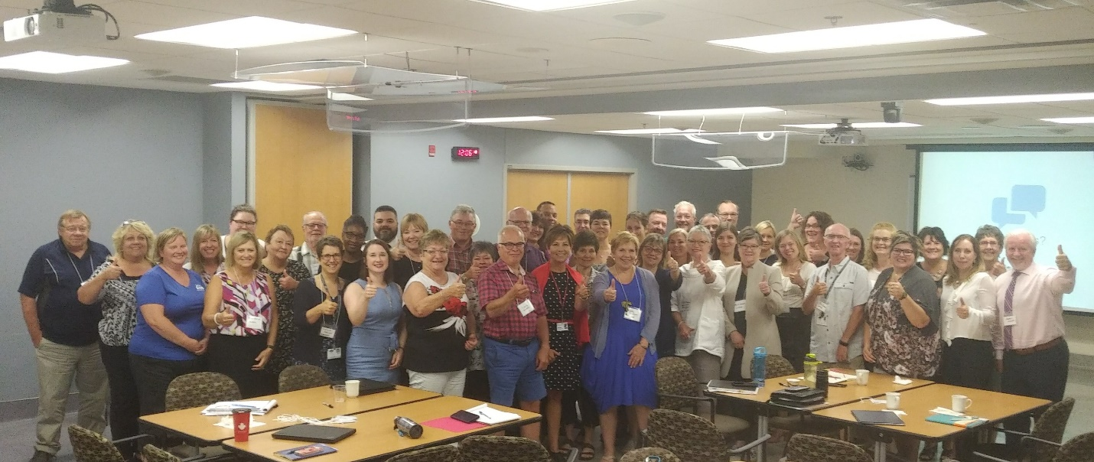
Purpose
To provide an update on the work of the proposed Huron Perth & Area Ontario Health Team governance model.

Slide 3
Background
In Spring 2019, 52+ healthcare organizations joined together to complete a Self Assessment in an effort to become one of the first Ontario Health Teams.
An Ontario Health Team is a new Ministry of Health service delivery model that emphasizes greater integration across healthcare providers.
Ministry Definition: “groups of providers and organizations that are clinically and fiscally accountable for delivering a full and coordinated continuum of care to a defined geographic population”
This team is made up of members from various health sectors, including:
Hospitals
Home Care
Community Support Services
Long-Term Care Homes
Mental Health and Addictions Agencies
Primary Care Providers
*Note: includes palliative and midwifery services

Slide 4
Full Application
Section 1 – About your population
Section 2 – About your team
Section 3 – How will you transform care?
Section 4 – How will your team work together?
Section 5 – How will your team learn and improve?
Section 6 – Implementation planning and risk analysis
Section 7 – Membership Approval
Appendix A – Home & Community Care
Appendix B – Digital Health
Due to the Ministry October 9, 2019

Slide 5
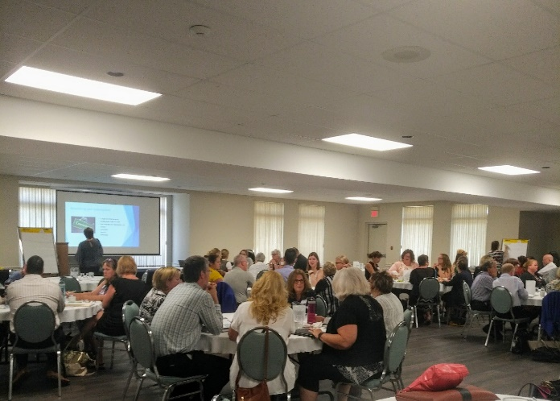
HP&A OHT Process
Identified coordinators for each of the 7 sections.
Certain sections have working group meetings.
Coordinators are responsible to consult with primary contacts in the sectors identified for involvement and draft the response on behalf of the OHT.
Engagement of clinical providers in all sessions.
Digital Health Working Group
Communications Working Group (*new*)
Week In Review Emails
Council Meetings
Patient/Staff Engagement
Community Town Hall

Slide 6
Governance Engagement Sessions
Facilitated Session – Structuring Options with Anne Corbett
Facilitated Session – Considerations for Collaborative Agreement
Rise Resources
Decision Making/Conflict Resolution/PM/IT/Resource Allocation
Agree on Principles/Elements of MOU
Confirm Interim Governance Structure
Solidify Next Steps
Over 650 engagement hours with 50-80 partners over 1 month

Slide 7
Target Population
The Huron Perth and Area Ontario Health Team will continue to provide full care to the 140,000 residents in their catchment area throughout this process and if accepted as an Ontario Health Team, has also agreed to work together to strengthen efforts around the following three target populations:
Mental Health & Addictions
Palliative
Complex

Slide 8
Draft Directional Strategies
Vision (Draft)
A sustainable people-driven system that strives to provide a positive experience for all
Commitments (Draft)
We will embrace change to enrich the lives of citizens and put community health outcomes first
We will create relationships based on trust and commit organizational resources towards collective improvement
We will deliver evidence-based, fiscally responsible and sustainable care
We will pursue opportunities to eliminate gaps, duplication and provide seamless care
People will partner together for effective decision-making

Slide 9
Keys to Success / Principles
OHT governance will include Clinical/Physician leadership
OHT governance will have Patient / Family / Community involvement
OHT governance / membership will ensure consideration for: skills, geography and sector representation
OHT will have a unified digital health plan that works from current state
OHT will allow organizational fundraising to remain in the community
OHT will maintain status quo funding in Year 1 as the team establishes strong decision making, conflict resolution, resource allocation, etc.
OHT will have a strong communications plan for Year 1+ to ensure all organizations are aware of substantives changes across organizations and geographies
OHT will include a focus on population health management
OHT will be evidence based and data driven

Slide 10
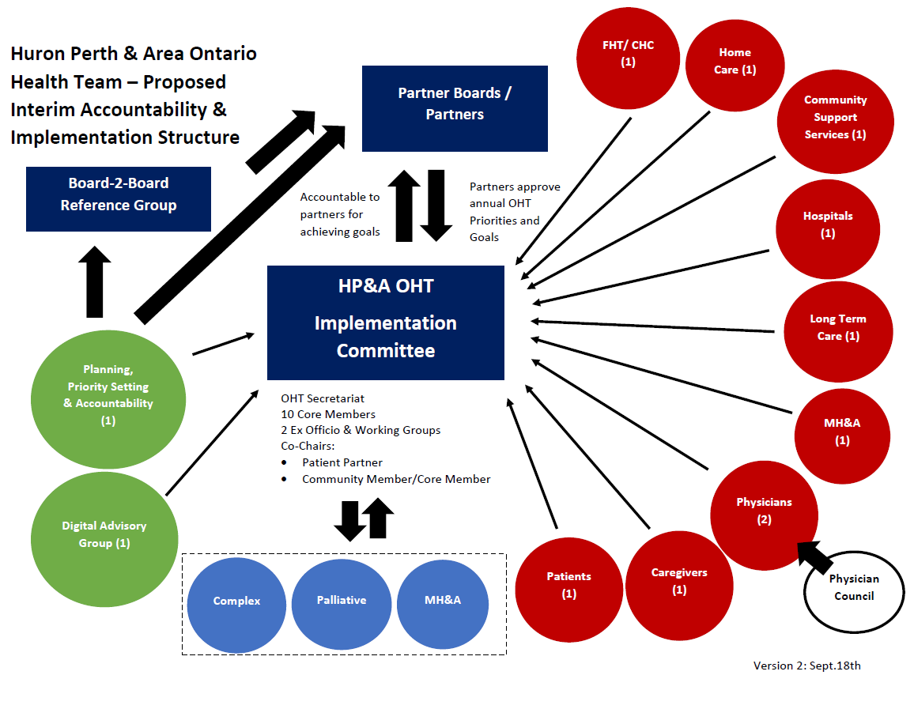

Slide 11
Ask from Board of Directors
To seek board endorsement/approval to allow board chair sign off on the Full Application once complete.

Slide 12
Challenges / Successes / Next Steps
Timing
Staff/ Physician Resources and Engagement
Strong Relationships in Huron and Perth
Existing Collaboration – Health links / Connecting the Dots
If Selected…
Agreement
Selecting Coordinating Committee
Memorandum of Understanding / Terms of Reference
“Change Happens at the Speed of Trust”

Slide 13

Organized Primary Care – The Missing Link?
“Holding a series of primary care stakeholder meetings inclusive of board chairs, EDs and lead physicians to develop the vision for PC within our OHT”
“All boards have agreed to pass an identical motion at their board meetings to enable a joint venture in year one and agreeing to collaborative governance beyond that”
“Survey distributed by physician leader to affiliated/non-affiliated MDs asking how they want to be involved”
“Utilizing a physician endorsement form to support a shared purpose and vision as well as priorities of focus (MH&A; palliative care + complex pts) as identified at an all partner symposium”
“Hosting targeted primary care clinician OHT info session in collaboration with SGFP, Ontario MD + AFHTO to provide information and to better understand how OHTs can support clinicians in our community”

Slide 14
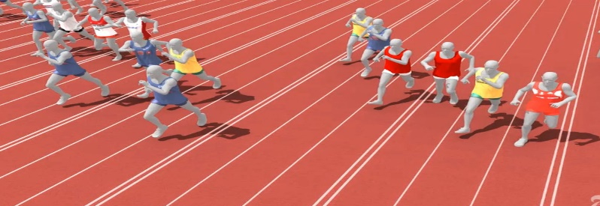
OHT 100m Dash – The Race from Shared Leadership to Shared Governance
“Representatives from all partners various boards are working together to determine a longer term governance structure”
“Hosting a series of governance meetings with board members of each partner organization with a facilitated discussion about shared purpose, objectives, principles of working together and collaborative agreements”
“All partners have signed on to an MOU that clearly outlines our commitment to work together and partnership expectations”
“Hosting our first series of OHT info webinars to keep broader stakeholders informed of the progress”
“We made this temporary website so that any interested partner can see relevant information”
“Implemented a terms of reference for the secretariat or each work stream”

