Slide 1



INFORMATION FOR CLINICIAN PARTNERS
To Refer a Patient:
Call local OPTIMUM Recruitment Line
1-866-539-3510
REB REF #086/2016

Slide 2
Patient-Centered Outcomes Research: “Research Done Differently”
This project is funded by the Patient-Centered Outcomes Research Institute
  A Non-profit organization
  Created by the ACA: funded by US treasury, Medicare and Medicaid, and a fee on commercial insurance.
What is different about this type of research?
  Comparative effectiveness trials: Which treatment works best, for which patient, in real world care settings?
  Stakeholder engagement: Patients, physicians, and families are intentionally involved in every stage of the research process.

Slide 3
You are an important part of the team
INTRODUCTION
The OPTIMUM study team partners with you to treat older adults with depression.
Toronto is one of five OPTIMUM sites.
You are at the center of this study!
Patients stay with their own provider.
Provider prescribes medication.
Study team guides treatment steps.
THE STUDY
We are
there to support both patient and provider!
THE DETAILS

Slide 4
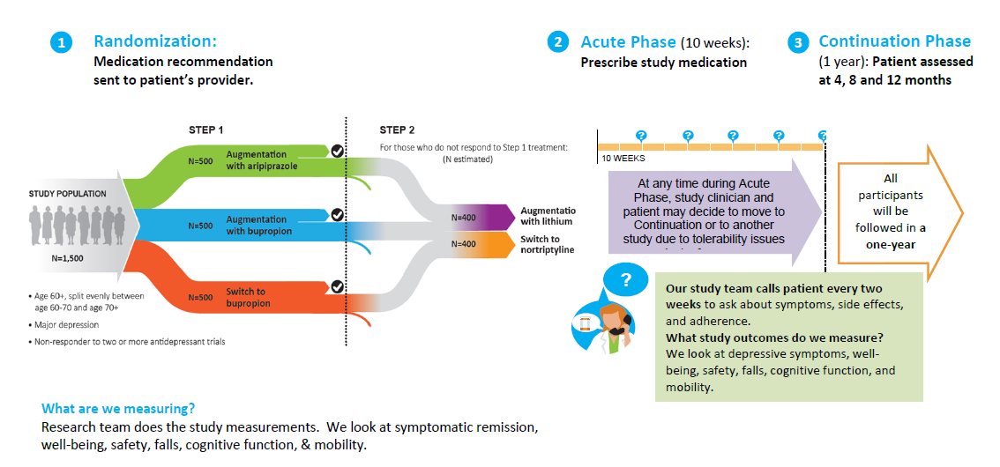
OPTIMUM Study Design

Slide 5
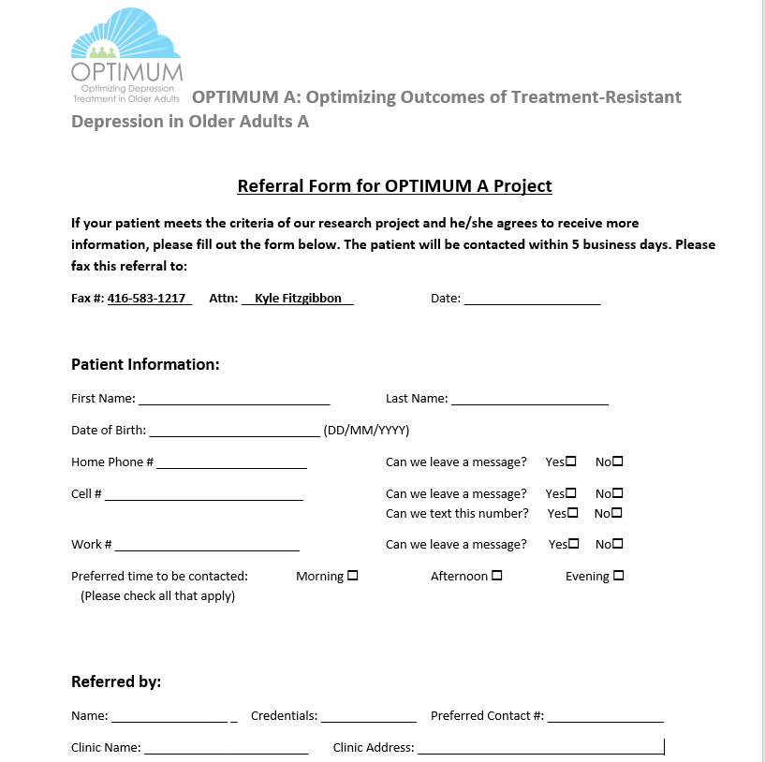
How to Refer to OPTIMUM

Slide 6
Study questions or concerns?
?
?
?
www.OPTIMUMstudy.org
TOGETHER, WE CAN FIND A BETTER TREATMENT
To refer a patient
call local OPTIMUM Recruitment Line:
1-866-539-3510
Medical questions about study patients and treatment:
Athina Perivolaris, RN
Athina.perivolaris@camh.ca
Benoit Mulsant, MD, MS, FRCPC
Benoit.mulsant@utoronto.ca
Tolu Adewole
Tolulope.adewole@camh.ca

